Slide 1



MAESTRO-X: Distributed Orchestration of Rotary-Wing UAV Relay Swarms via SMDPs
Bharath Keshavamurthy
School of Electrical, Computer and Energy Engineering,
Arizona State University, Tempe, AZ

Slide 2
Agenda
Motivation
Problem Statement
State-of-the-art: Approaches & Drawbacks
System Model: Deployment | Communication | Channel | Power
MAESTRO: Specialized single UAV relay approach via SMDPs and HCSO
MAESTRO-X: Generalized swarm orchestration | Optimal policy + multi-UAV heuristics
Numerical Evaluations
Future Work

Slide 3


Motivation

Slide 4
Motivation
Need for multi-tier/non-terrestrial Radio Access Networks (RANs):
Sustained device proliferation
Advanced next-generation RANs promising URLLC services
Intensive data-driven applications spanning nearly every sector
Massive OPEX and CAPEX in horizontally scaling terrestrial RANs
R&D emphasis on:
Unmanned Aerial Vehicles (UAVs);
High Altitude Platforms (HAPs); and
Low Earth, Medium Earth, & Geostationary Earth Orbit (LEO, MEO, GEO) satellites
operating cooperatively to offload traffic, extend coverage, and enhance QoS.
We study a few commercial applications of Non-Terrestrial Networks.

Slide 5

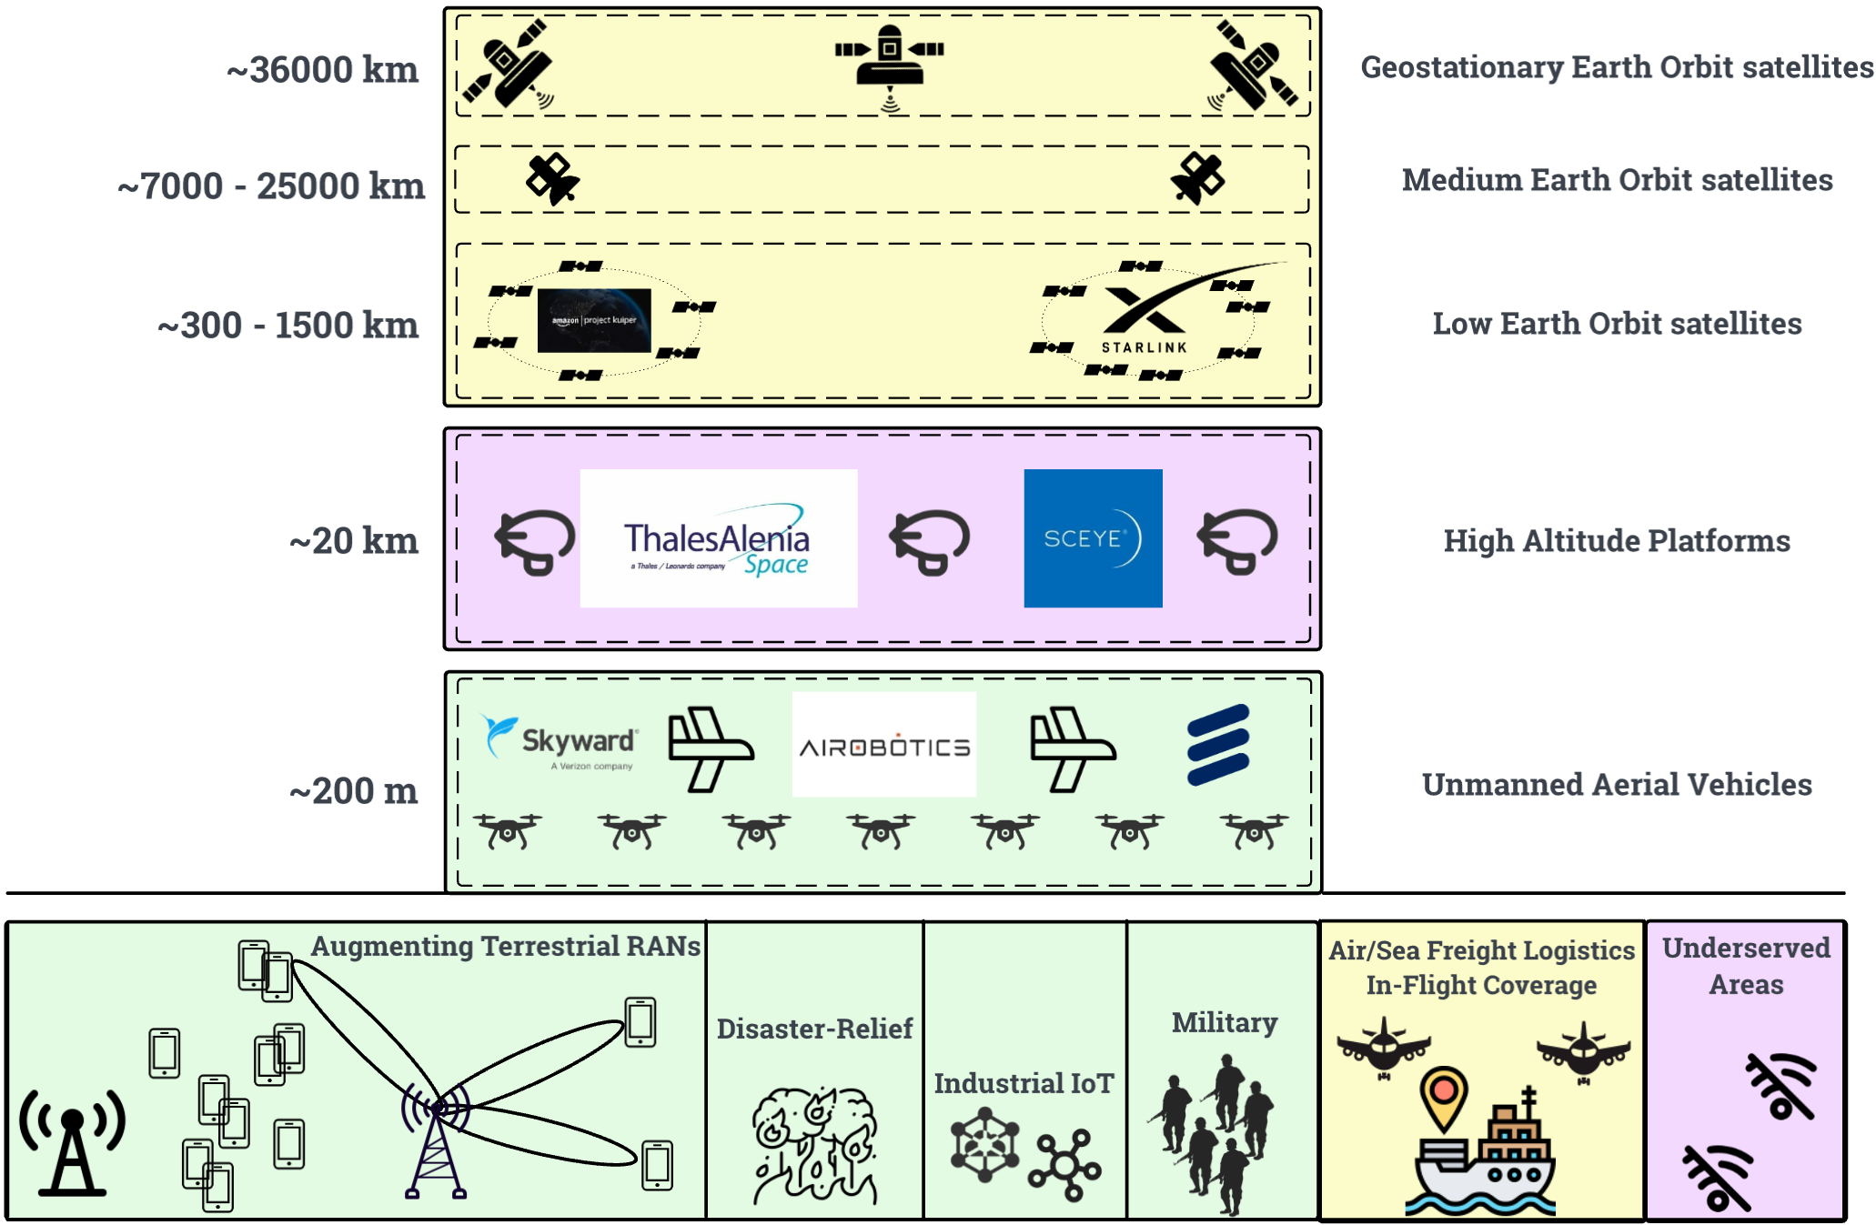
Visualizing the vertical integration of Non-Terrestrial Networks

Slide 6
Motivation: Applications I (Satellites & HAPs)
Thales-Alenia Stratobus Platform (French/EU military communications)
Sceye (Navajo Nation universal broadband access, mMIMO A2G Open RAN)
SpaceX Starlink Consumer services (isolated areas, war/disaster affected regions)
SpaceX Starlink Business services (Delta in-flight broadband, air/sea freight connectivity)
Softbank Skylo Narrowband IoT connectivity services (commercial fishing, freight logistics)
We focus on the UAV layer.
We first study commercial R&D in this layer and then detail the specifics of our research.

Slide 7
Motivation: Applications II (UAVs)
3D Mobility & Maneuverability of UAVs can be leveraged in:
Public-Safety
Disaster-Relief
Precision Agriculture
Military Deployments
URLLC QoS guarantees (e.g., Industrial IoT)

Slide 8
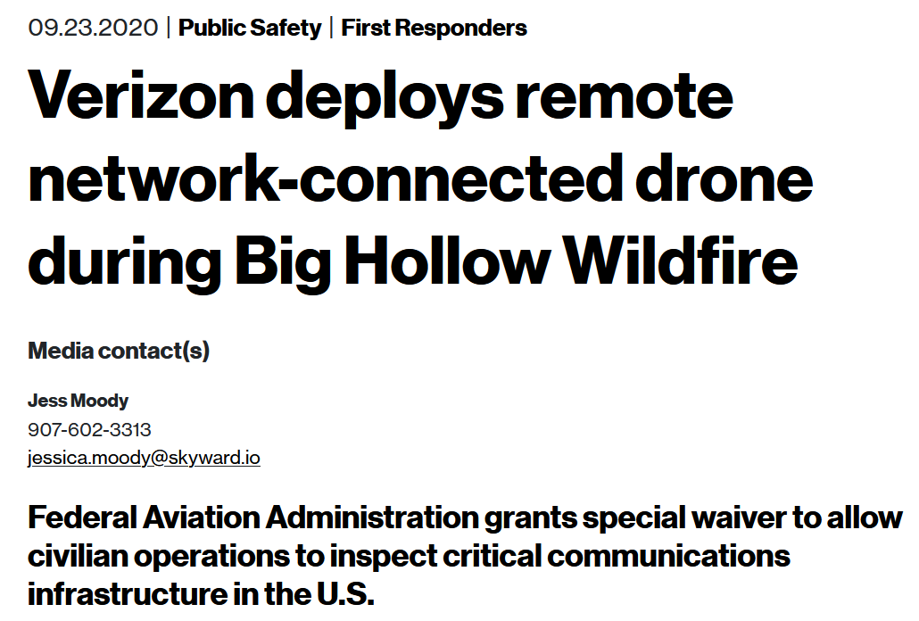
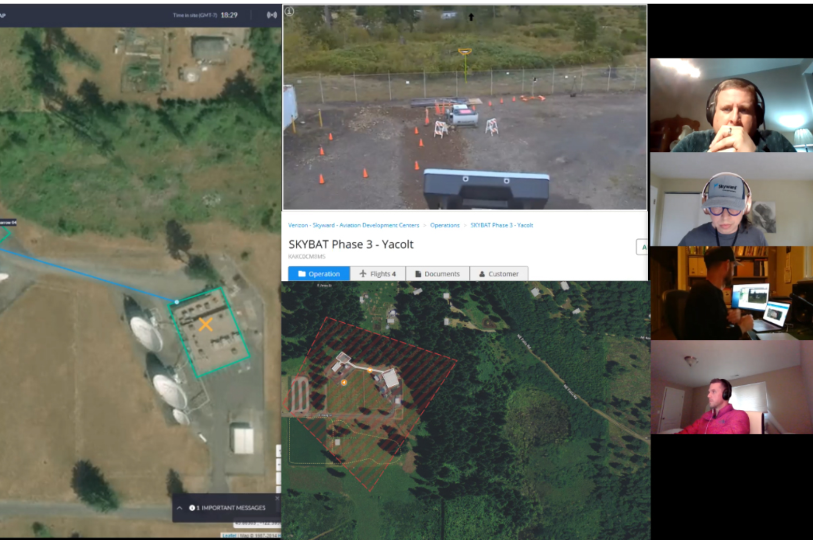
UAVs in Disaster-Relief
Verizon-Skyward LTE-enabled UAV-management platform monitoring infrastructure during the Big Hollow fire in WA

Slide 9

5G-enabled Drone Surveillance
Verizon 5G use-case for monitoring public-safety risks via connected autonomous drones

Slide 10
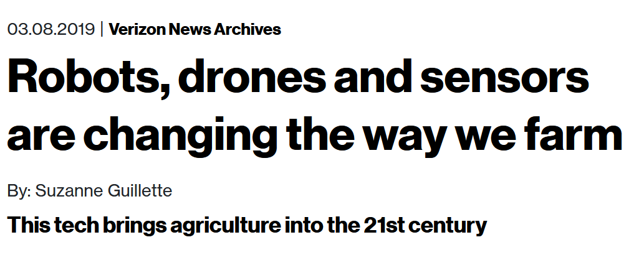
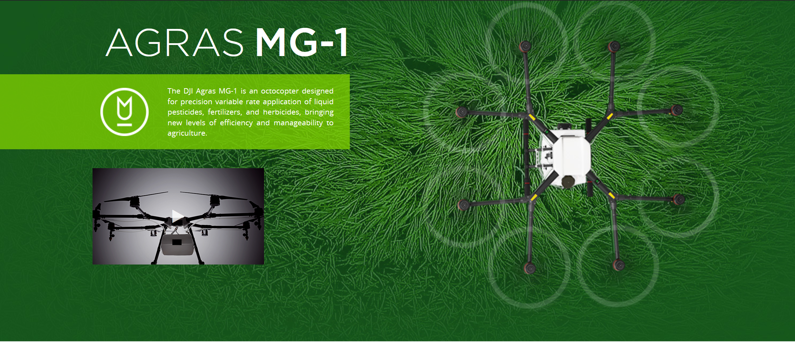
UAVs in Precision Agriculture
Verizon-Skyward precision agriculture use-cases:
Automating DJI AGRAS MG-1 UAVs
Data Harvesting or Coverage Extension* for
VIGOR soil sensors
MooCall livestock monitors
AgOpenGPS seeding workflows
Autonomous harvesters
Ecorobotix weeding
*Especially crucial for Millimeter Wave Communications
Keshavamurthy, B., Zhang, Y., et al. (2021). A Robotic Antenna Alignment and Tracking System for Millimeter Wave Propagation Modeling. arXiv, abs/2110.07106.

Slide 11

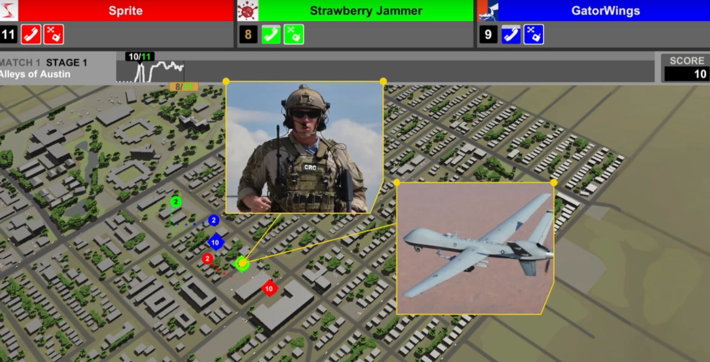
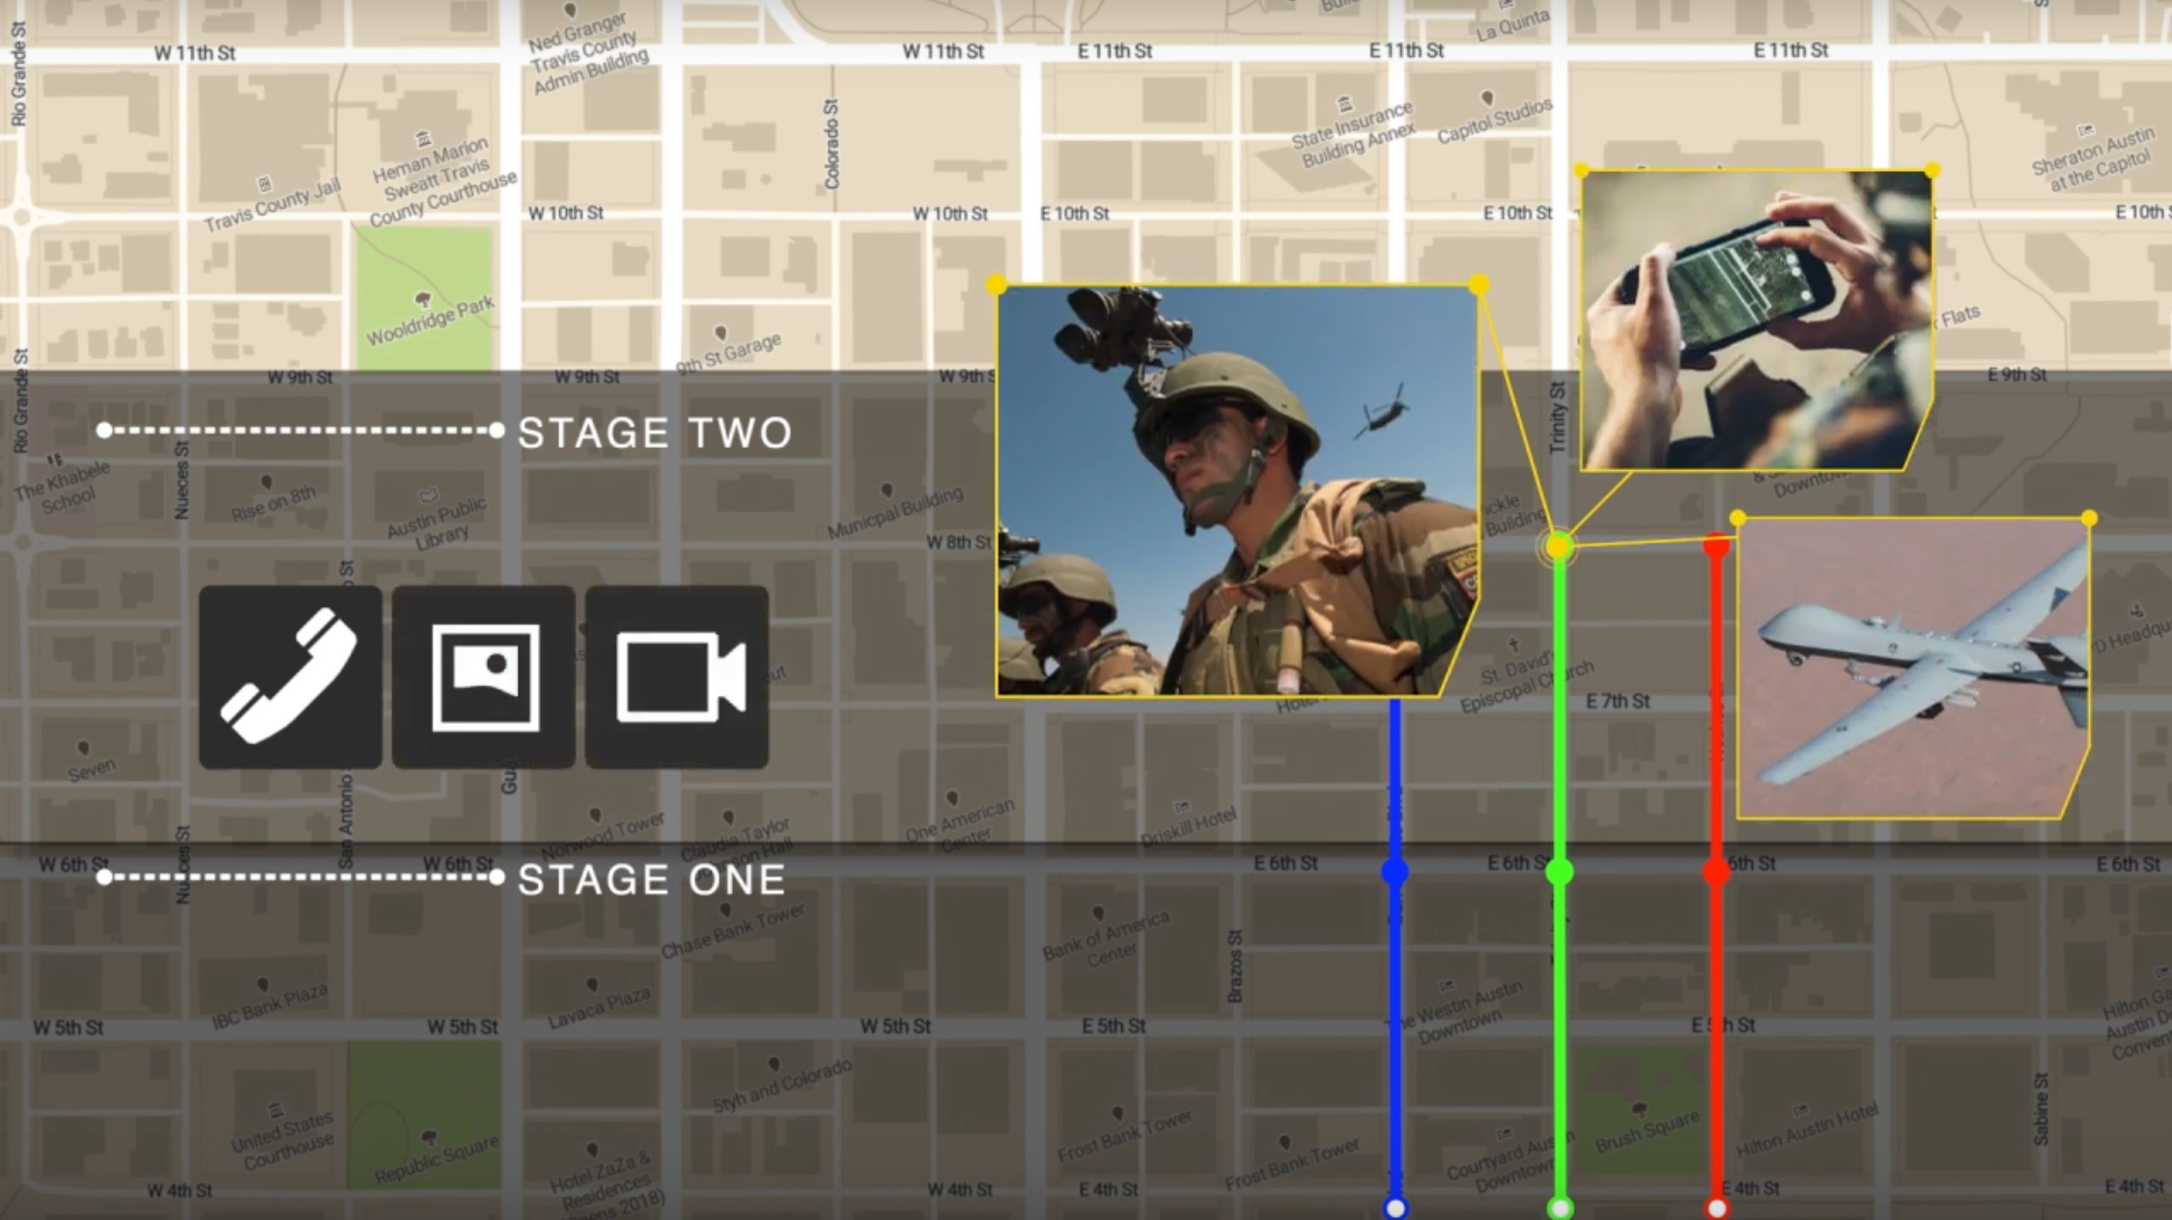
UAVs in Military Deployments: DARPA SC2
B. Keshavamurthy and N. Michelusi, "Learning-based Spectrum Sensing and Access in Cognitive Radios via Approximate POMDPs," in IEEE Transactions on Cognitive Communications and Networking, doi: 10.1109/TCCN.2021.3129802.

Slide 12



UAVs for URLLC QoS
Case Study: Industrial Automation
Ultra-Reliable Low-Latency Communication
Heterogeneous sets of sensors and actuators
Achieving Industrial Automation via 5G (Ericsson + Audi)
Monitoring process-critical parameters (Airobotics)

Slide 13
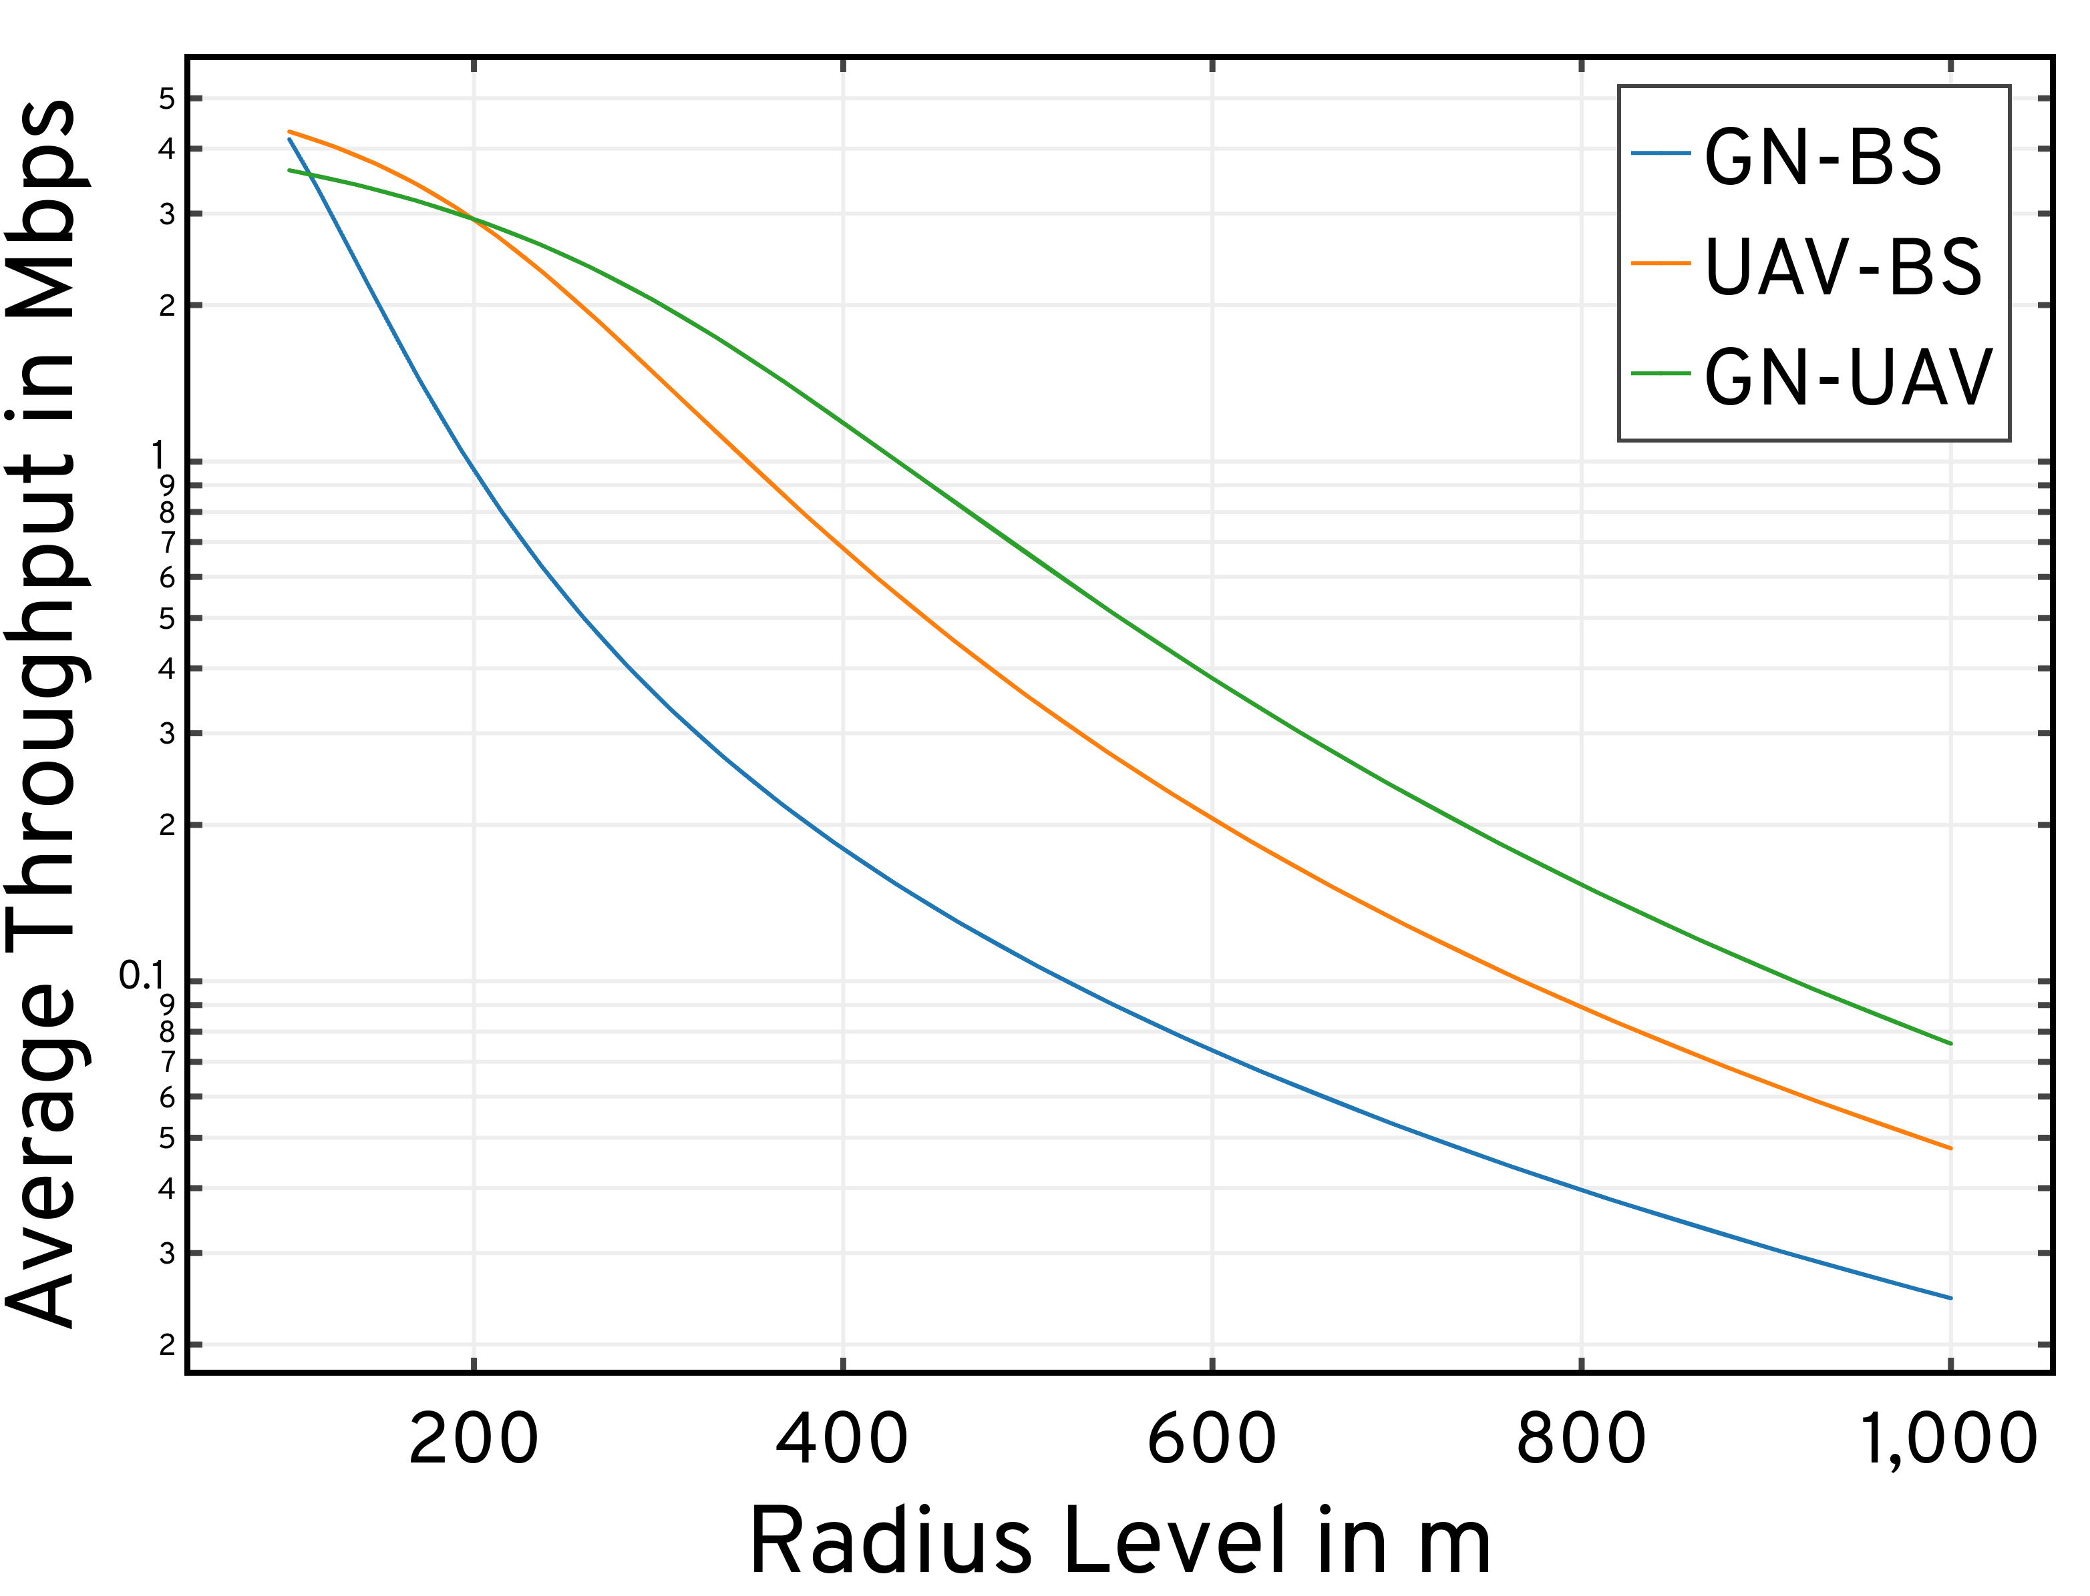
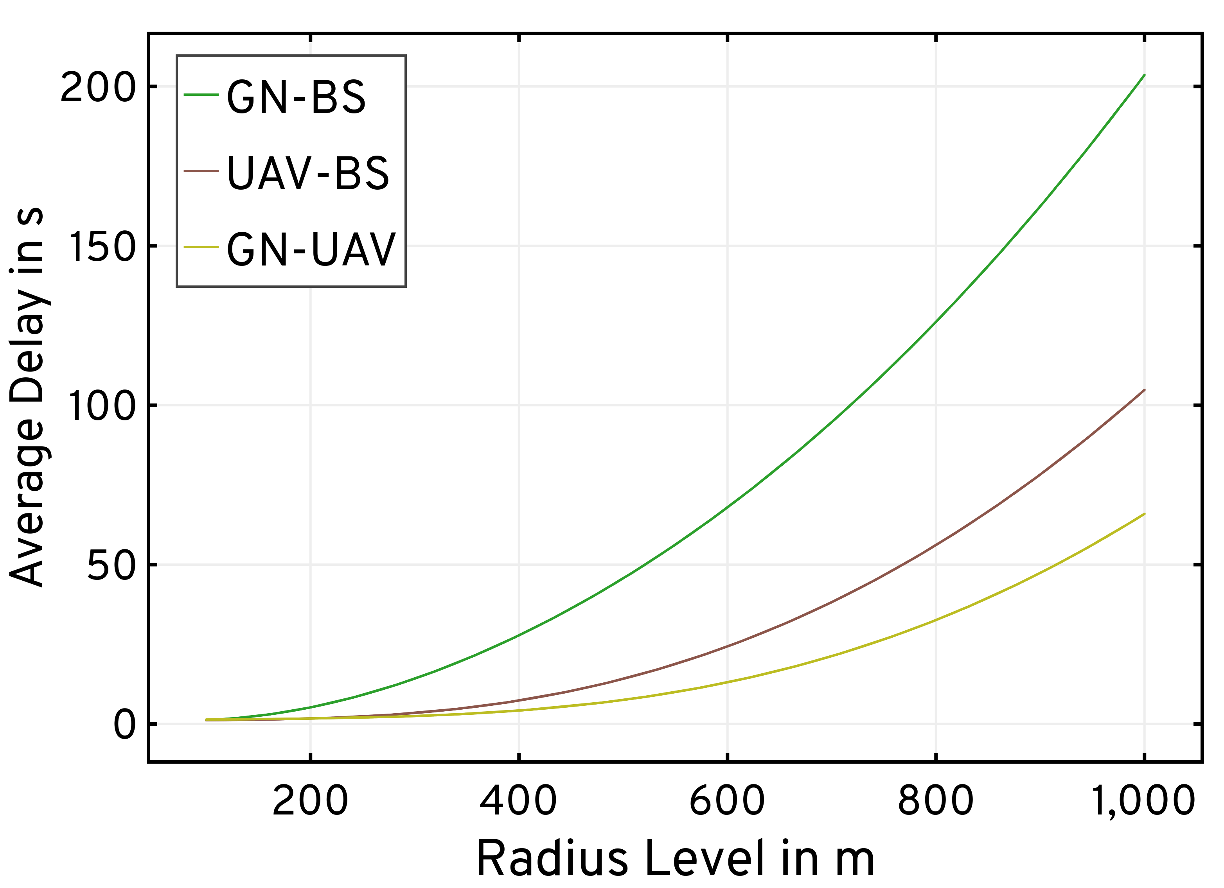
GNs farther away from the BS experience poor path-loss conditions and attenuations due to NLoS propagation (BVLoS/blockages)
Motivation: A2G Channel Model | GN-BS Service Delays

Slide 14

Problem Specifics

Slide 15
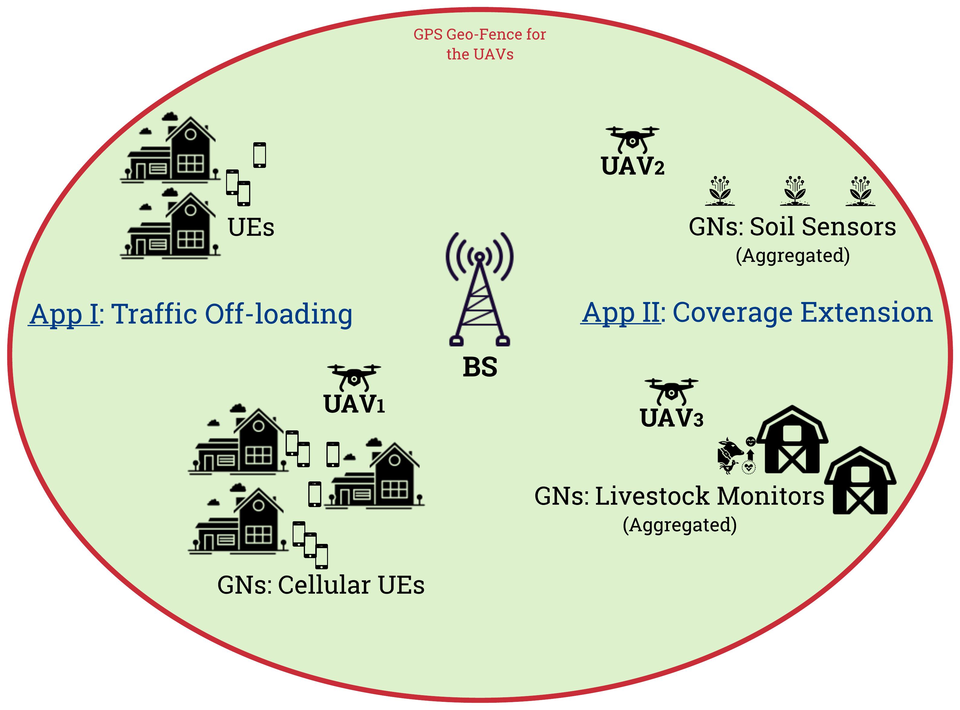
Problem Statement
Control: Dynamic traffic from Ground Nodes (GNs)
Channel Model: Air-to-Ground (A2G) Channel Stochastics
Formulation: Computational feasibility | Trajectory design
Multi-Agent: Distributed coordination | Command & Control
Objective: Optimizing QoS mandates versus on-board UAV energy constraints
Deployment: Orchestrating a swarm of UAVs serving as cellular relays for augmenting a terrestrial Base Station (BS) via traffic offloading and coverage extension

Slide 16
State-of-the-art: Approaches & Drawbacks
Control [1, 2, 3, 4]:
Non-adaptive
Deterministic traffic models
Unreasonable assumptions on GN capabilities
Approaches rely on Successive Convex Approximation (SCA):
Tackles non-convex problems with iterative optimization involving convex approximations at a local point
Involves prohibitively large policy convergence times
Precludes the incorporation of dynamic traffic models
Channel Model [1,2,3,4]:
Inaccurately employ free space pathloss models
Fail to exploit the A2G channel characteristics
SCA: Approximations in data payload delivery constraints to enforce convexity
[1] Y. Zeng et al., “Energy Minimization for Wireless Communication With Rotary-Wing UAV,” IEEE Transactions on Wireless Communications, vol. 18, no. 4, pp. 2329–2345, April 2019.
[2] M. A. Abd-Elmagid and H. S. Dhillon, “Average Peak Age-of-Information Minimization in UAV-Assisted IoT Networks,” IEEE Transactions on Vehicular Technology, vol. 68, no. 2, pp. 2003–2008, 2019.
[3[ X. Hu et al., “UAV-Assisted Relaying and Edge Computing: Scheduling and Trajectory Optimization,” IEEE Transactions on Wireless Communications, vol. 18, no. 10, pp. 4738–4752, 2019
[4] C. You and R. Zhang, “3D Trajectory Optimization in Rician Fading for UAV-Enabled Data Harvesting,” IEEE Transactions on Wireless Communications, vol. 18, no. 6, pp. 3192–3207, 2019

Slide 17
State-of-the-art: Approaches & Drawbacks
UAV Trajectory Design:
Static positioning [1,2,3]
SCA [4]: Approximations in mobility model constraints to enforce convexity
Restricted Mobility: Fixed forward flying velocity [4] | Impractical path structures [3]
Particle Swarm Optimization (PSO) [1,2,3] is inefficient (limited update scope) and computationally intractable
UAV Deployment:
Single UAV deployments are insufficient [1,2,3,4]
Centralized swarm control suffers from higher OPEX and CAPEX [5,6]
Joint multi-UAV constructions [7,8] lead to prohibitively large solution spaces
[1] H. Shakhatreh et al., “Efficient 3D placement of a UAV using particle swarm optimization,” in 2017 8th International Conference on Information and Communication Systems (ICICS), 2017, pp. 258–263.
[2] Z. Yuheng et al., “3-D Deployment Optimization of UAVs Based on Particle Swarm Algorithm,” in 2019 IEEE 19th International Conference on Communication Technology (ICCT), 2019, pp. 954–957.
[3] R. K. Patra, P. Muthuchidambaranathan, “Optimisation of Spectrum and Energy Efficiency in UAV-Enabled Mobile Relaying Using Bisection and PSO Method,” in 2018 International Conference for Convergence in Technology (I2CT), 2018, pp. 1–7.
[4] M. A. Abd-Elmagid and H. S. Dhillon, “Average Peak Age-of-Information Minimization in UAV-Assisted IoT Networks,” IEEE Transactions on Vehicular Technology, vol. 68, no. 2, pp. 2003–2008, 2019.
[5] Q. Wu et al., “Joint Trajectory and Communication Design for Multi-UAV Enabled Wireless Networks,” IEEE Transactions on Wireless Communications, vol. 17, no. 3, pp. 2109–2121, 2018.
[6] M. Mozaffari et al., “Efficient Deployment of Multiple Unmanned Aerial Vehicles for Optimal Wireless Coverage,” IEEE Communications Letters, vol. 20, no. 8, pp. 1647–1650, 2016.
[7] Q. Hu et al., “Low-Complexity Joint Resource Allocation and Trajectory Design for UAV-Aided Relay Networks With the Segmented Ray-Tracing Channel Model,” IEEE Transactions on Wireless Communications, vol. 19, no. 9, pp. 6179–6195, 2020.
[8] A. E. A. A. Abdulla et al., “Toward Fair Maximization of Energy Efficiency in Multiple UAS-Aided Networks: A Game-Theoretic Methodology,” IEEE Transactions on Wireless Communications, vol. 14, no. 1, pp. 305–316, Jan 2015.

Slide 18
State-of-the-art: Approaches & Drawbacks
Overall Formulation [1,2]:
Model-free frameworks
Combined state- and action-spaces
Fail to effectively capture the problem structure
Typically resulting in large policy convergence times
Link Layer Studies:
Approaches forgo queuing analyses
Those that do consider queueing dynamics, do so only at the GNs [3]
[1] H. Bayerlein et al., “Multi-UAV Path Planning for Wireless Data Harvesting With Deep Reinforcement Learning,” IEEE Open Journal of the Communications Society, vol. 2, p. 1171–1187, 2021.
[2] L. Wang et al., “Multi-Agent Deep Reinforcement Learning-Based Trajectory Planning for Multi-UAV Assisted Mobile Edge Computing,” IEEE Transactions on Cognitive Communications and Networking, vol. 7, no. 1, pp. 73–84, 2021.
[3] A. M. Koushik et al., “Deep Q -Learning-Based Node Positioning for Throughput-Optimal Communications in Dynamic UAV Swarm Network,” IEEE Transactions on Cognitive Communications and Networking, vol. 5, no. 3, pp. 554–566, 2019.

Slide 19
Our Contributions: Objective
Minimize the time-average service delay subject to an average UAV power constraint:
Optimize UAV operations in both waiting and communication service phases
Our problem exhibits a multiscale structure: Waiting & Communication states | Two-layer decision-making
Multiscale Adaptive Energy-conscious Scheduling and TRajectory Optimization (MAESTRO)

Slide 20
Our Contributions: Addressing the challenges
Adaptive Control:
UAVs relay dynamically-generated traffic from miscellaneous sets of randomly distributed GNs
Non-SCA approach allows for a control framework that is adaptive to uncertain system dynamics
A Semi-Markov Decision Process (SMDP) formulation captures temporal irregularities in state transitions
A2G Channel Model:
Accurately model A2G channel characteristics along BS-UAV and GN-UAV links
Incorporation of rate-adaptation at all transmitters to maximize system throughput
Our SMDP formulation mitigates approximations in the data payload delivery constraints

Slide 21
Our Contributions: Addressing the challenges
UAV Trajectory Design:
Hierarchical Competitive Swarm Optimization (HCSO)
Unlike SCA, CSO does not rely on a specific problem structure
Unlike PSO, CSO has more efficient updates via pair-wise competition
Distributed Swarm Deployments:
Decoupled executions via policy replication across the swarm
Overlay a fully-connected mesh network for command & control
Multi-UAV heuristics for spread maximization and conflict resolution
M/G/x queuing models incorporated at both the BS as well as the UAVs
QoS studies include queue wait times and queue management heuristics

Slide 22
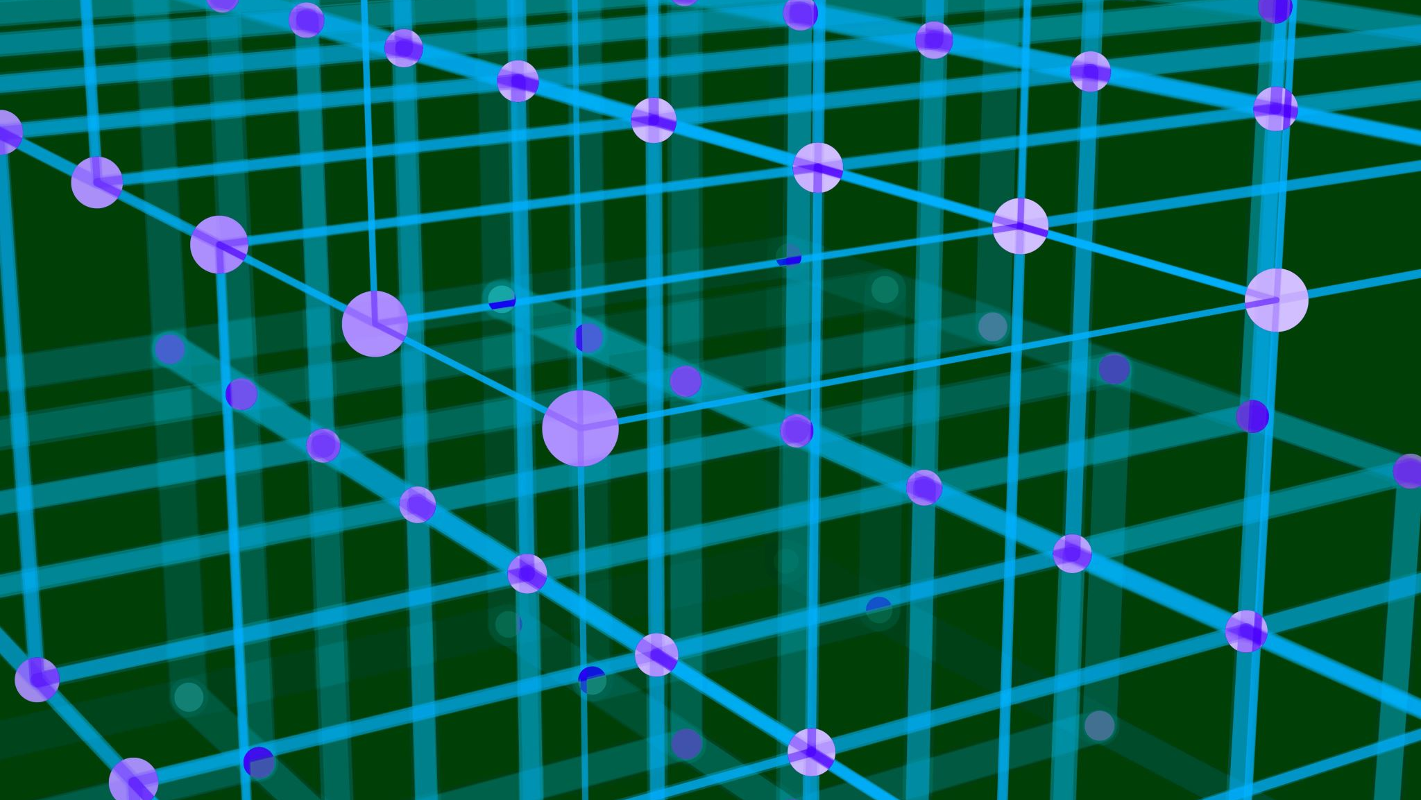
System Model

Slide 23
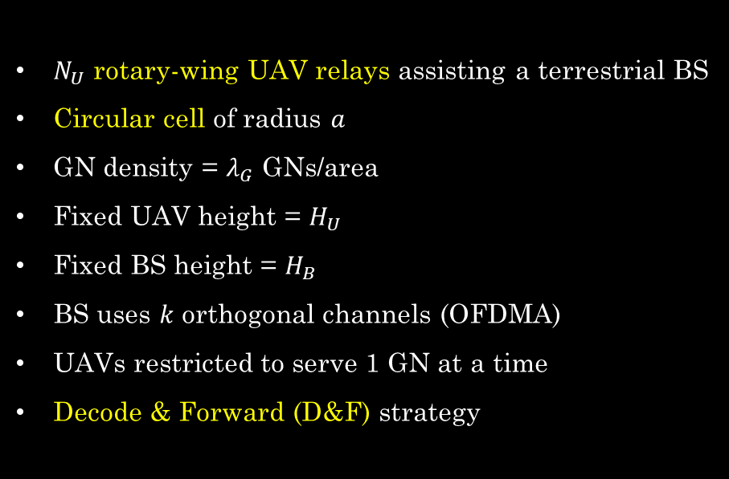
System Model: Deployment
$N_{U}$ rotary-wing UAV relays assisting a terrestrial BS
Circular cell of radius $a$
GN density = $λ_{G}$ GNs/area
Fixed UAV height = $H_{U}$
Fixed BS height = $H_{B}$
BS uses $k$ orthogonal channels (OFDMA)
UAVs restricted to serve 1 GN at a time
Decode & Forward (D&F) strategy
A sample deployment in precision agriculture/mechanized farming (Not to scale)

Slide 24
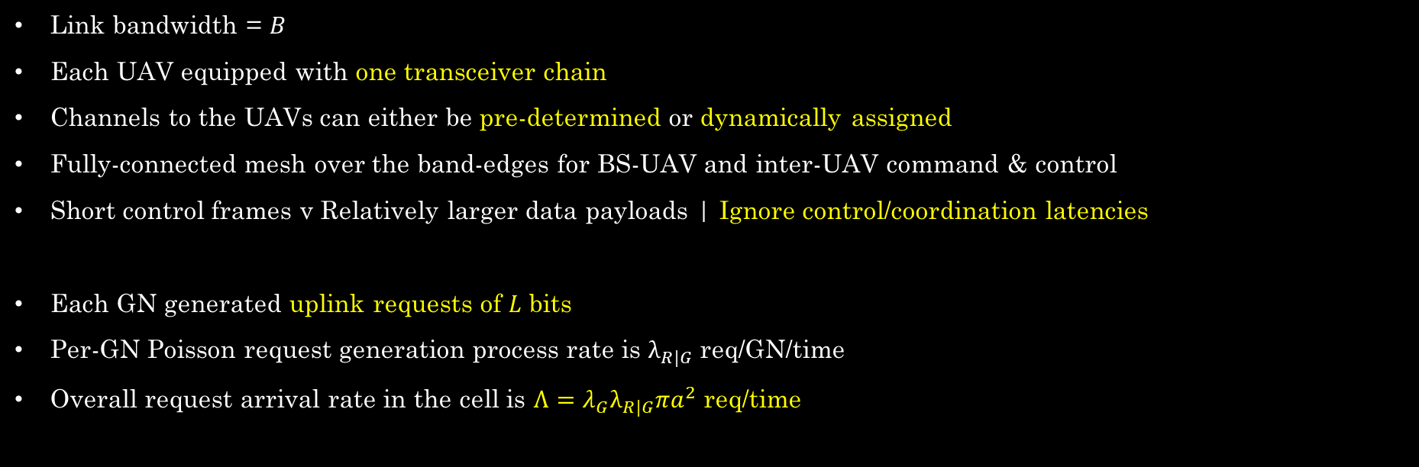
System Model: Communication
Link bandwidth = $B$
Each UAV equipped with one transceiver chain
Channels to the UAVs can either be pre-determined or dynamically assigned
Fully-connected mesh over the band-edges for BS-UAV and inter-UAV command & control
Short control frames v Relatively larger data payloads | Ignore control/coordination latencies
Each GN generated uplink requests of $L$ bits
Per-GN Poisson request generation process rate is $λ_{R|G}$ req/GN/time
Overall request arrival rate in the cell is $Λ=λ_{G}λ_{R|G}πa^{2}$ req/time

Slide 25
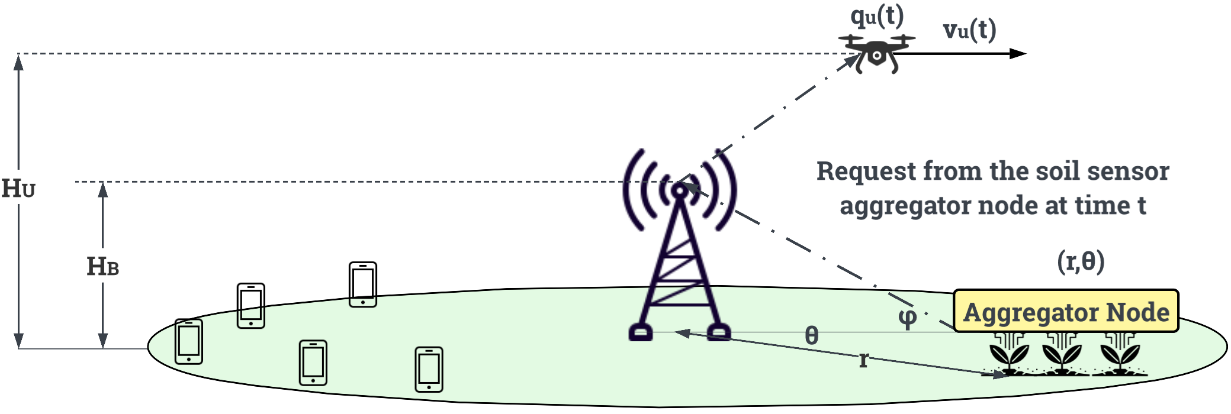
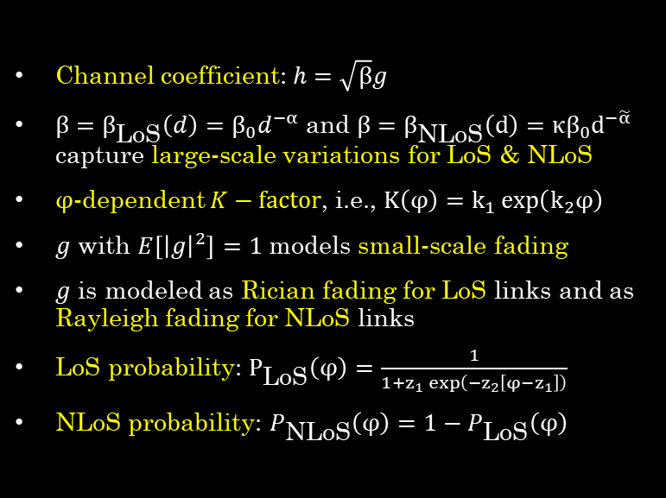
System Model: Channel
Channel coefficient: $h=\sqrt{β}g$
$β=β_{\text{LoS}}\left(d\right)=β_{0}d^{−α}$ and $β=β_{\text{NLoS}}\left(d\right)=κβ_{0}d^{−\tilde{α}}$ capture large-scale variations for LoS & NLoS
$φ$-dependent $K−factor$, i.e., $K\left(φ\right)=k_{1}\exp\left(k_{2}φ\right)$
$g$ with $E\left[{\left|g\right|}^{2}\right]=1$ models small-scale fading
$g$ is modeled as Rician fading for LoS links and as Rayleigh fading for NLoS links
LoS probability: $P_{\text{LoS}}\left(φ\right)=\frac{1}{1+z_{1}\exp\left(−z_{2}\left[φ−z_{1}\right]\right)}$
NLoS probability: $P_{\text{NLoS}}\left(φ\right)=1−P_{\text{LoS}}\left(φ\right)$
[1] C. You and R. Zhang, “3D Trajectory Optimization in Rician Fading for UAV-Enabled Data Harvesting,” IEEE Transactions on Wireless Communications, vol. 18, no. 6, pp. 3192–3207, 2019.
[2] A. Al-Hourani, S. Kandeepan, and S. Lardner, “Optimal LAP Altitude for Maximum Coverage,” IEEE Wireless Communications Letters, vol. 3, no. 6, pp. 569–572, 2014.
[3] D. Tse and P. Viswanath, Fundamentals of Wireless Communication. Cambridge: Cambridge University Press, 2005.
[4] R. Essaadali and A. Kouki, “A new simple Unmanned Aerial Vehicle doppler effect RF reducing technique,” in MILCOM 2016 - 2016 IEEE Military Communications Conference, 2016, pp. 1179–1183.

Slide 26
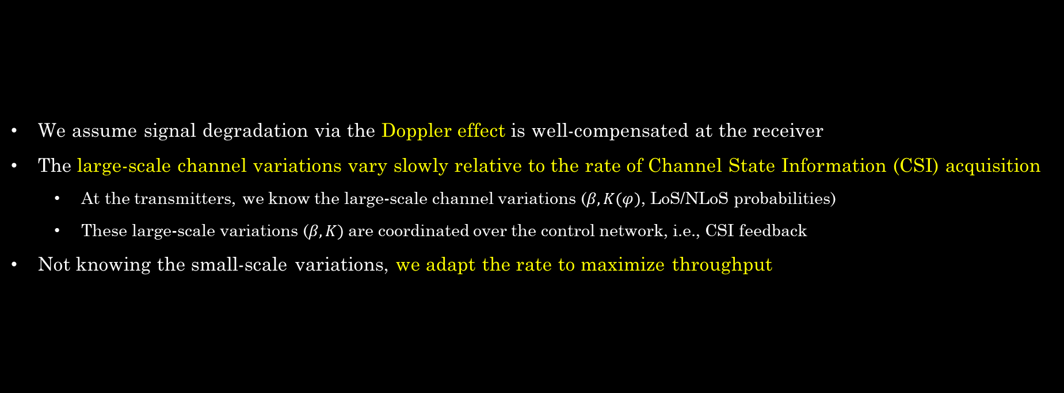
System Model: Channel
We assume signal degradation via the Doppler effect is well-compensated at the receiver
The large-scale channel variations vary slowly relative to the rate of Channel State Information (CSI) acquisition
At the transmitters, we know the large-scale channel variations ($β, K(φ)$, LoS/NLoS probabilities)
These large-scale variations ($β, K)$are coordinated over the control network, i.e., CSI feedback
Not knowing the small-scale variations, we adapt the rate to maximize throughput

Slide 27
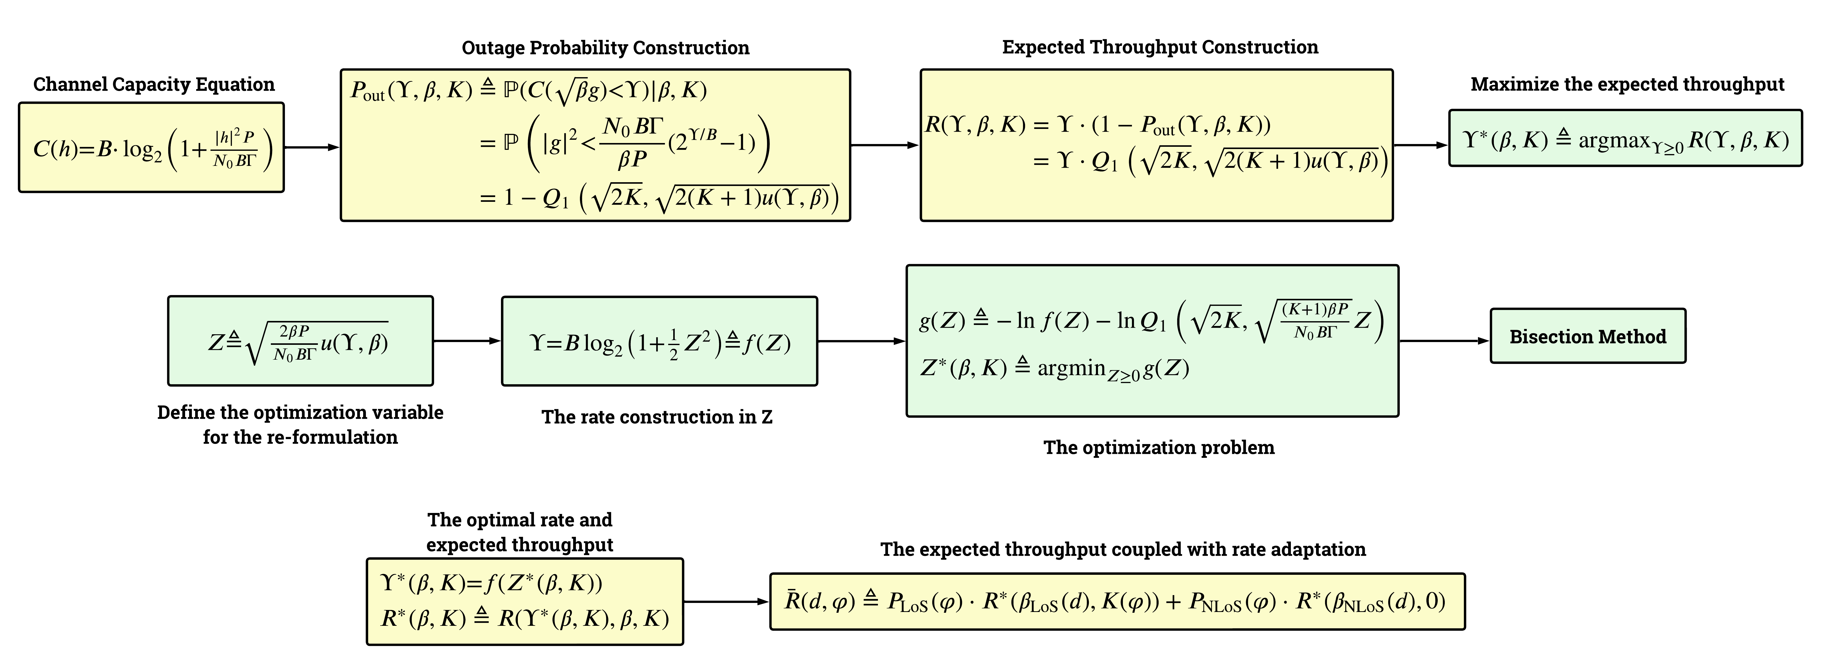
System Model: Channel | Rate Adaptation
The Constructions & Algorithmic Process Flow in our Rate Adaptation scheme

Slide 28
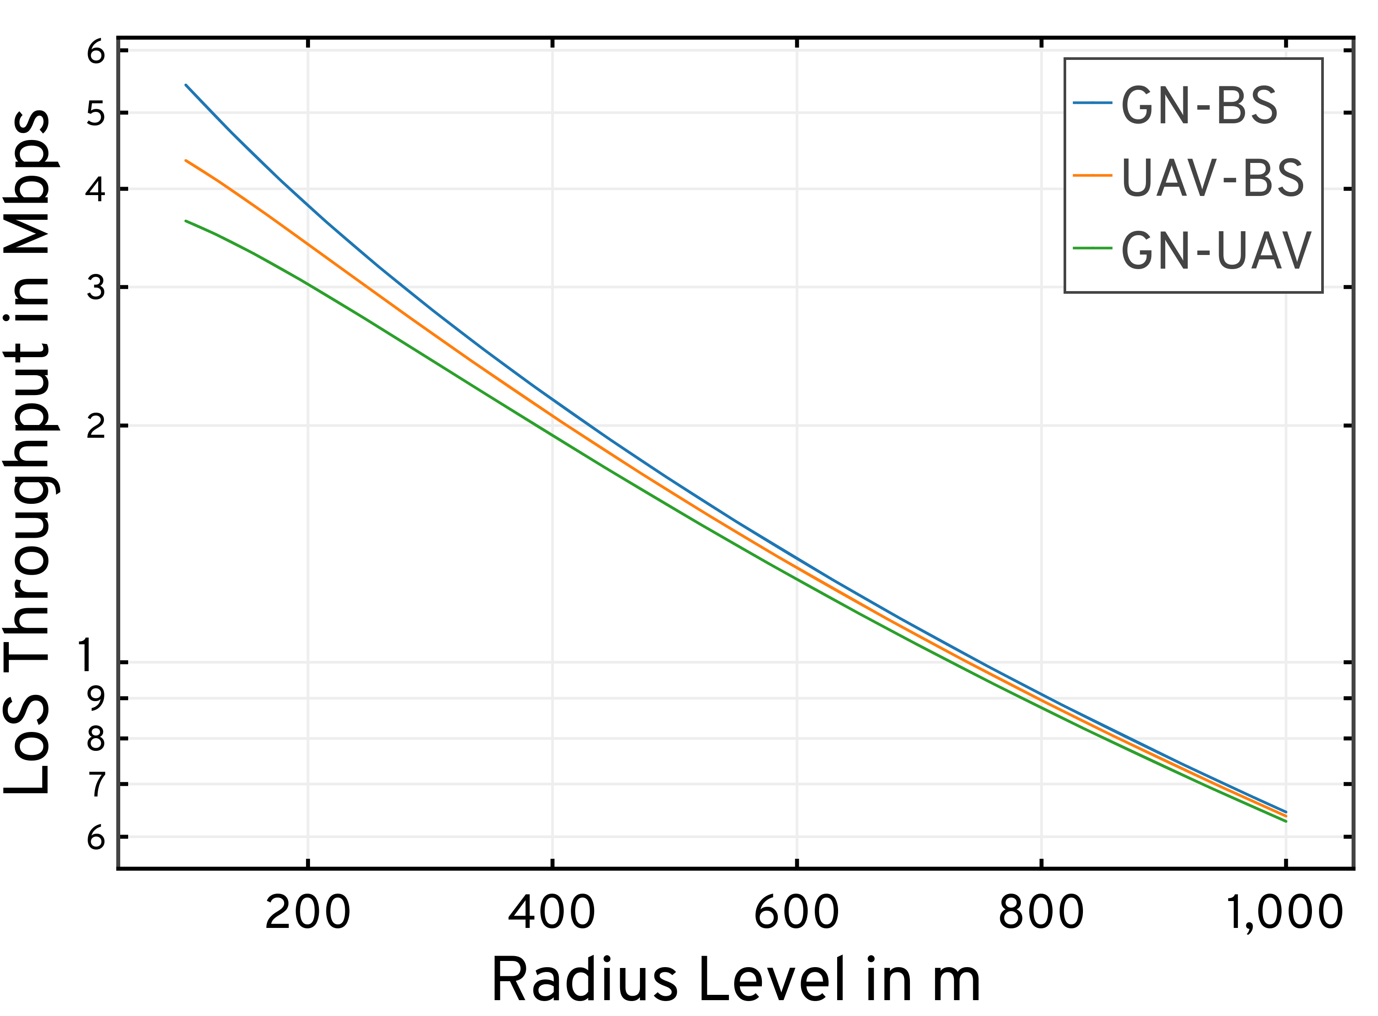
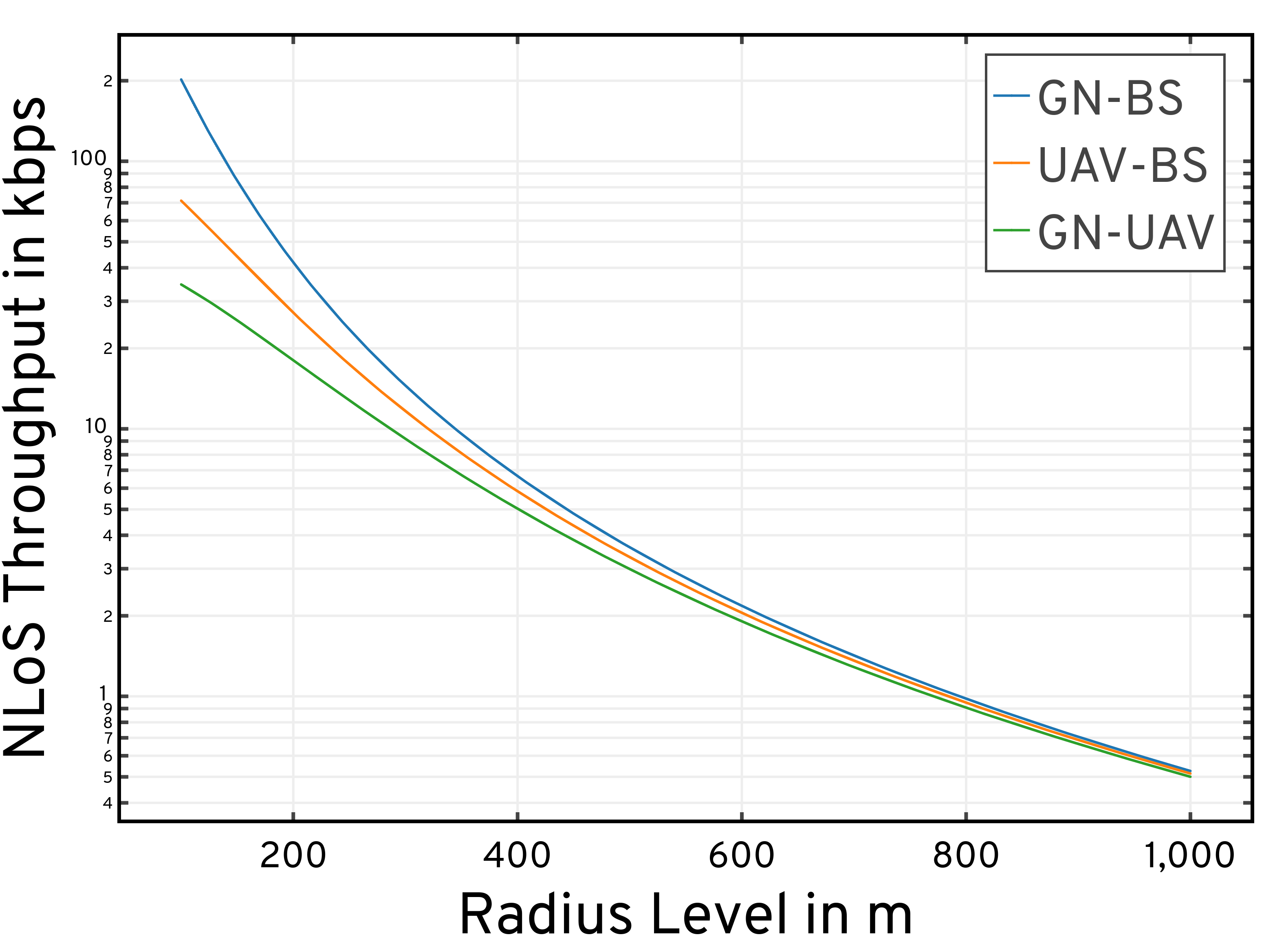
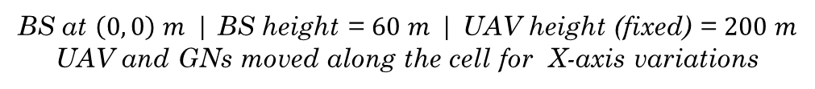
BS at $\left(0, 0\right) m$ | BS height = $60 m$ | UAV height (fixed) = $200 m$
UAV and GNs moved along the cell for X-axis variations
Performance: A2G Channel Model with Rate Adaptation

Slide 29
BS at $\left(0, 0\right) m$ | BS height = $60 m$ | UAV height (fixed) = $200 m$ | Data Payload = $5 Mb$
UAV and GNs moved along the cell for X-axis variations
As the Tx-Rx distance increases, the GN-BS link suffers from low $P_{LoS}$
This degradation is lower for the GN-UAV link due to the higher position of the UAV ($H_{U}>H_{B})$
Performance: A2G Channel Model with Rate Adaptation

Slide 30
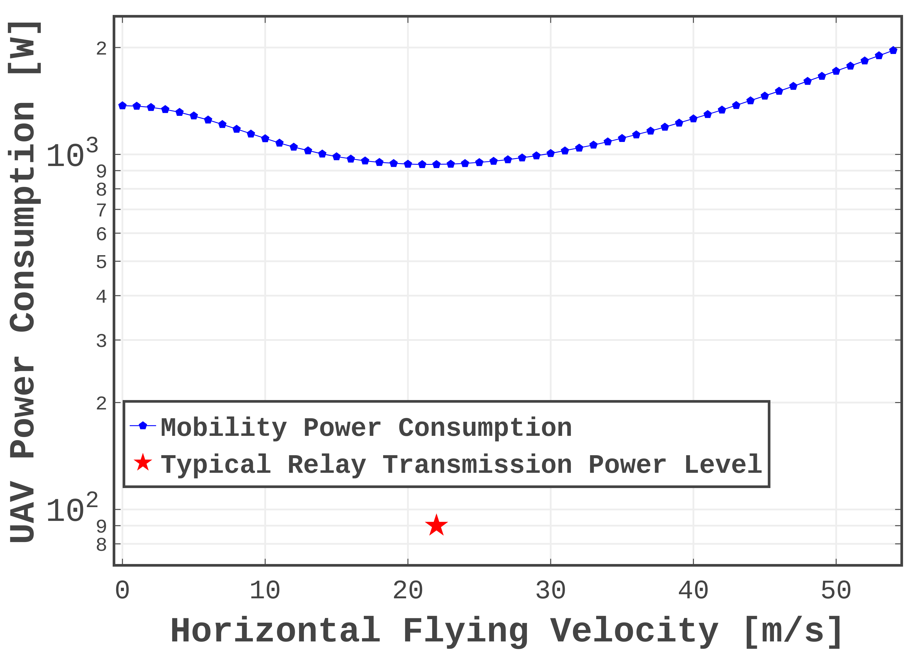

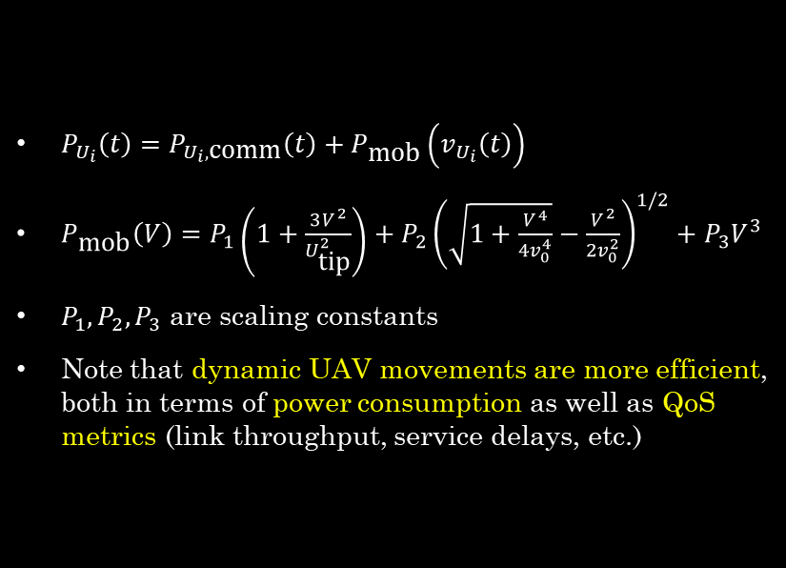
System Model: Power
UAV hover power consumption $≈1371 W$
UAV minimum power consumption at $22 m/s≈937 W$
$P_{U_{i}}\left(t\right)=P_{U_{i},\text{comm}}\left(t\right)+P_{\text{mob}}\left(v_{U_{i}}\left(t\right)\right)$
$P_{\text{mob}}\left(V\right)=P_{1}\left(1+\frac{3V^{2}}{U_{\text{tip}}^{2}}\right)+P_{2}{\left(\sqrt{1+\frac{V^{4}}{4v_{0}^{4}}}−\frac{V^{2}}{2v_{0}^{2}}\right)}^{1/2}+P_{3}V^{3}$
$P_{1},P_{2},P_{3}$ are scaling constants
Note that dynamic UAV movements are more efficient, both in terms of power consumption as well as QoS metrics (link throughput, service delays, etc.)
[1] Y. Zeng et al., “Energy Minimization for Wireless Communication With Rotary-Wing UAV,” IEEE Transactions on Wireless Communications, vol. 18, no. 4, pp. 2329–2345, April 2019.

Slide 31

Specialization: MAESTRO

Slide 32
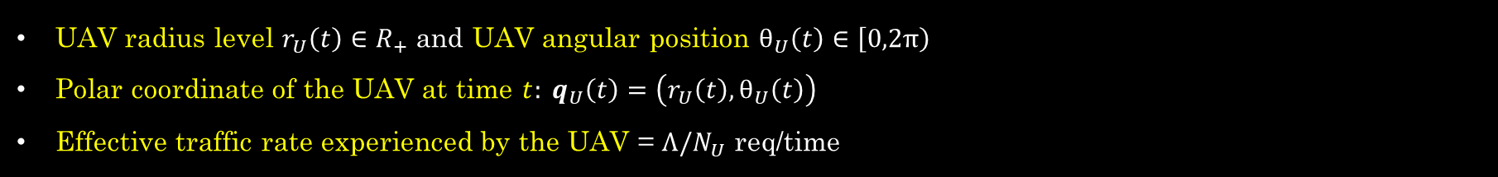
MAESTRO: Single-Agent Specialization
UAV radius level $r_{U}\left(t\right)∈R_{+}$ and UAV angular position $θ_{U}\left(t\right)∈\left[0,2π\right)$
Polar coordinate of the UAV at time $t: q_{U}\left(t\right)=\left(r_{U}\left(t\right),θ_{U}\left(t\right)\right)$
Effective traffic rate experienced by the UAV = $Λ/N_{U}$ req/time

Slide 33
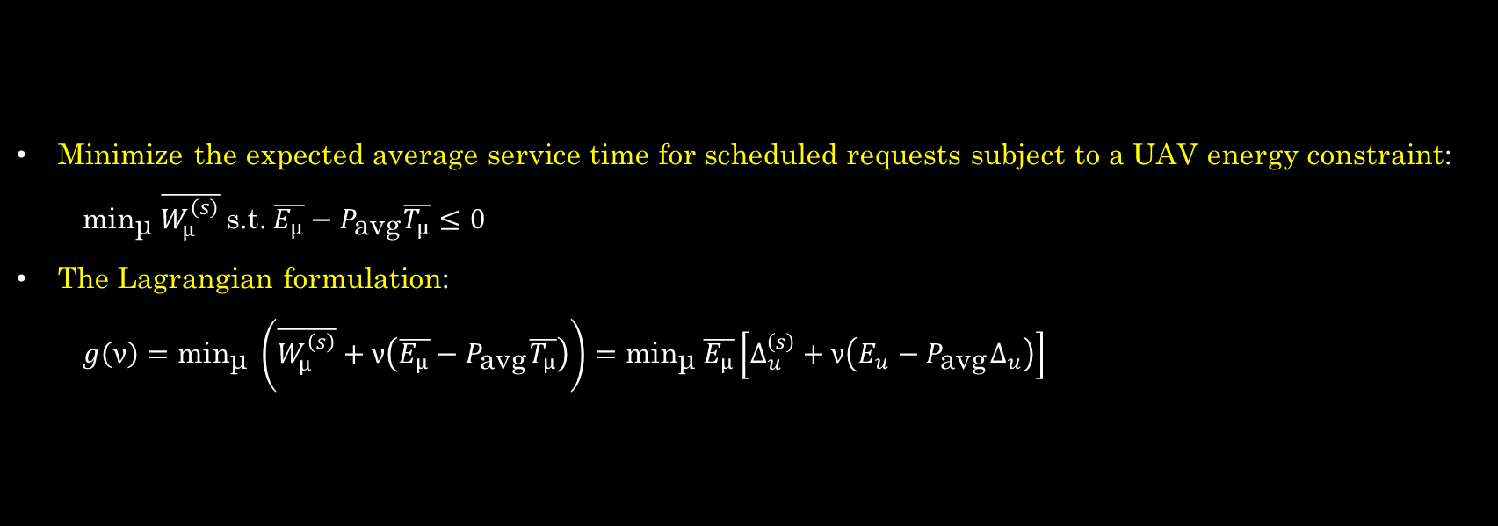
MAESTRO: The Optimization Problem
Minimize the expected average service time for scheduled requests subject to a UAV energy constraint:
$\text{mi}{\text{n}}_{\text{μ}} \overline{W_{μ}^{\left(s\right)}} \text{s}\text{.}\text{t}\text{.} \overline{E_{μ}}−P_{\text{avg}}\overline{T_{μ}}≤0$
The Lagrangian formulation:
$g\left(ν\right)=\text{mi}{\text{n}}_{\text{μ}} \left(\overline{W_{μ}^{\left(s\right)}}+ν\left(\overline{E_{μ}}−P_{\text{avg}}\overline{T_{μ}}\right)\right)=\text{mi}{\text{n}}_{\text{μ}} \overline{E_{μ}}\left[Δ_{u}^{\left(s\right)}+ν\left(E_{u}−P_{\text{avg}}Δ_{u}\right)\right]$

Slide 34
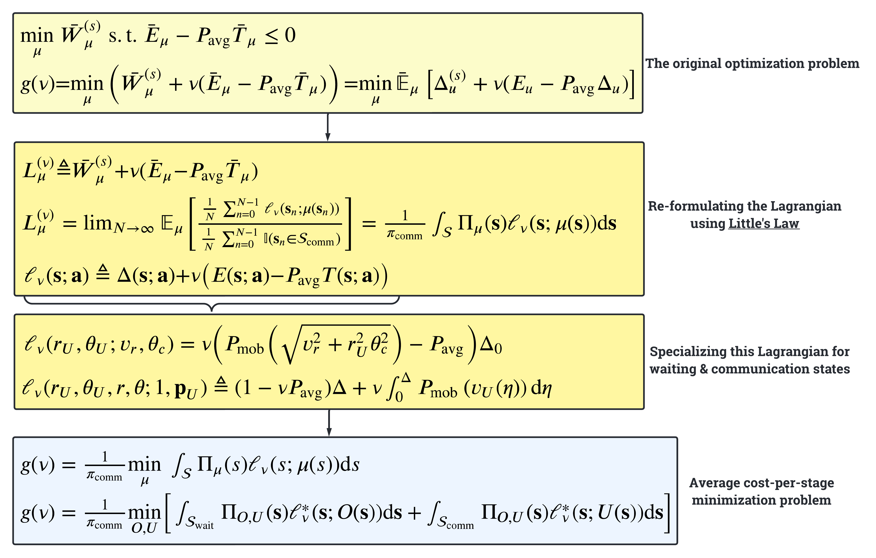
MAESTRO: Mathematical Constructions

Slide 35
MAESTRO: SMDP Formulation

Slide 36
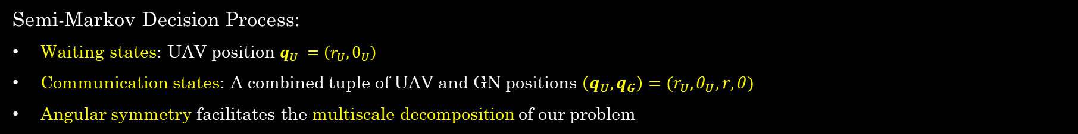
MAESTRO: SMDP Formulation | States
Semi-Markov Decision Process:
Waiting states: UAV position $q_{U} =\left(r_{U},θ_{U}\right)$
Communication states: A combined tuple of UAV and GN positions $\left(q_{U}, q_{G}\right)=(r_{U}, θ_{U}, r, θ)$
Angular symmetry facilitates the multiscale decomposition of our problem

Slide 37
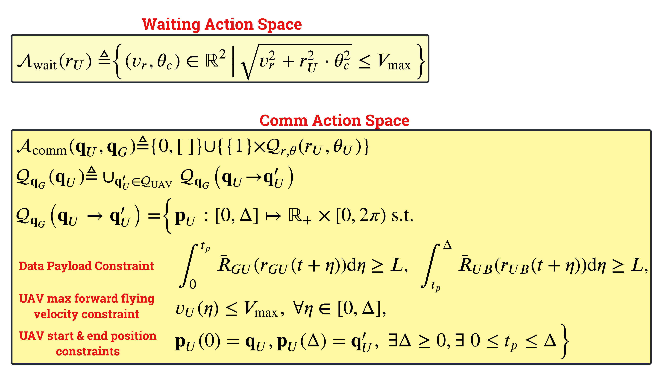
MAESTRO: SMDP Formulation | Actions

Slide 38
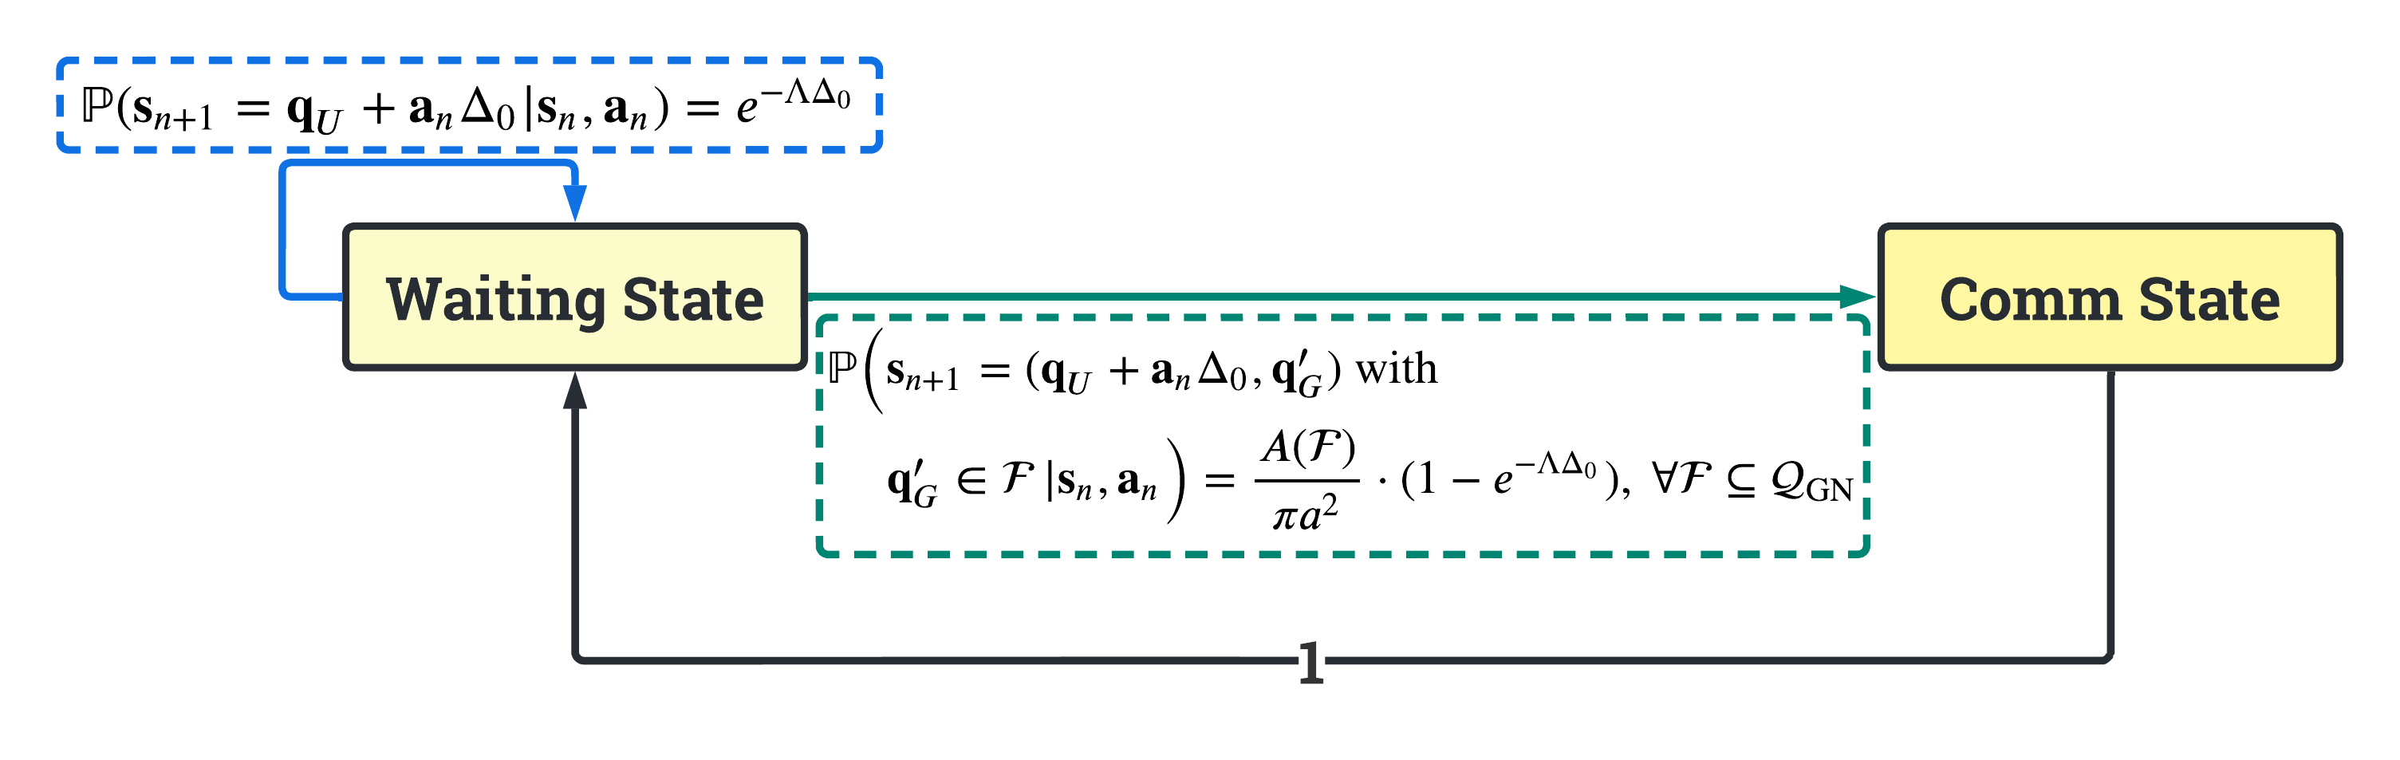
MAESTRO: SMDP Formulation | State Transitions

Slide 39
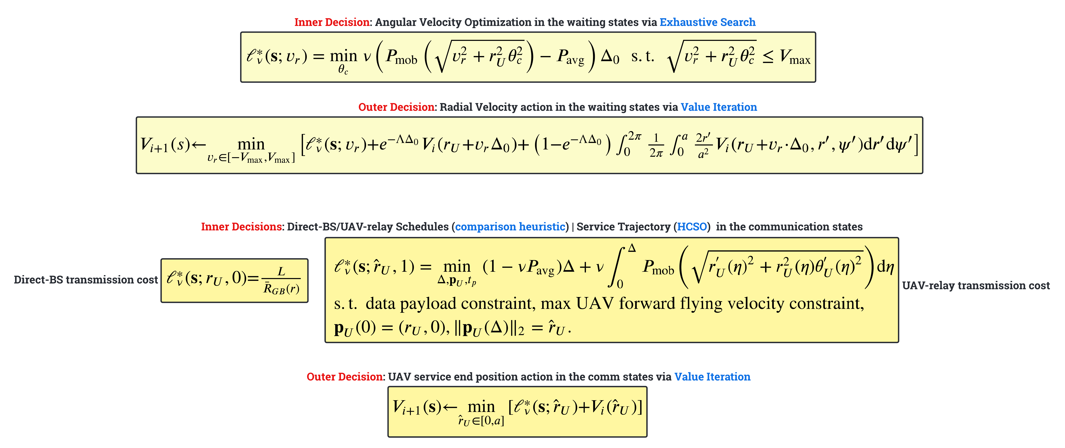
MAESTRO: SMDP Formulation | Solution Flow

Slide 40
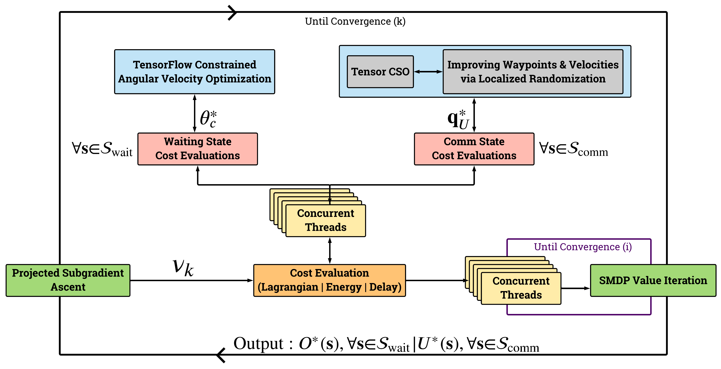
Waiting states: Inner Decision on UAV Angular Velocity
Comm states: Inner Decision on
UAV Service Trajectory
Waiting states: Outer Decision on UAV Radial Velocity
Comm states: Outer Decisions on
BS/UAV Service & UAV Terminal Position
Algorithmic Flow of the single-agent optimization process

Slide 41

MAESTRO: Trajectory Design via HCSO

Slide 42
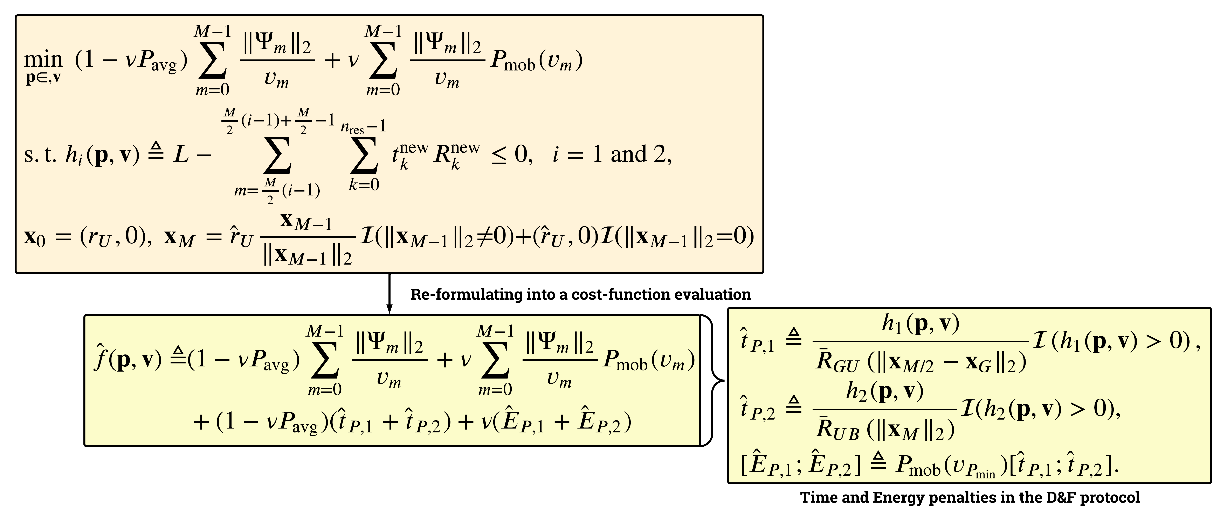
MAESTRO: Trajectory Design via HCSO | Mathematical Constructions

Slide 43
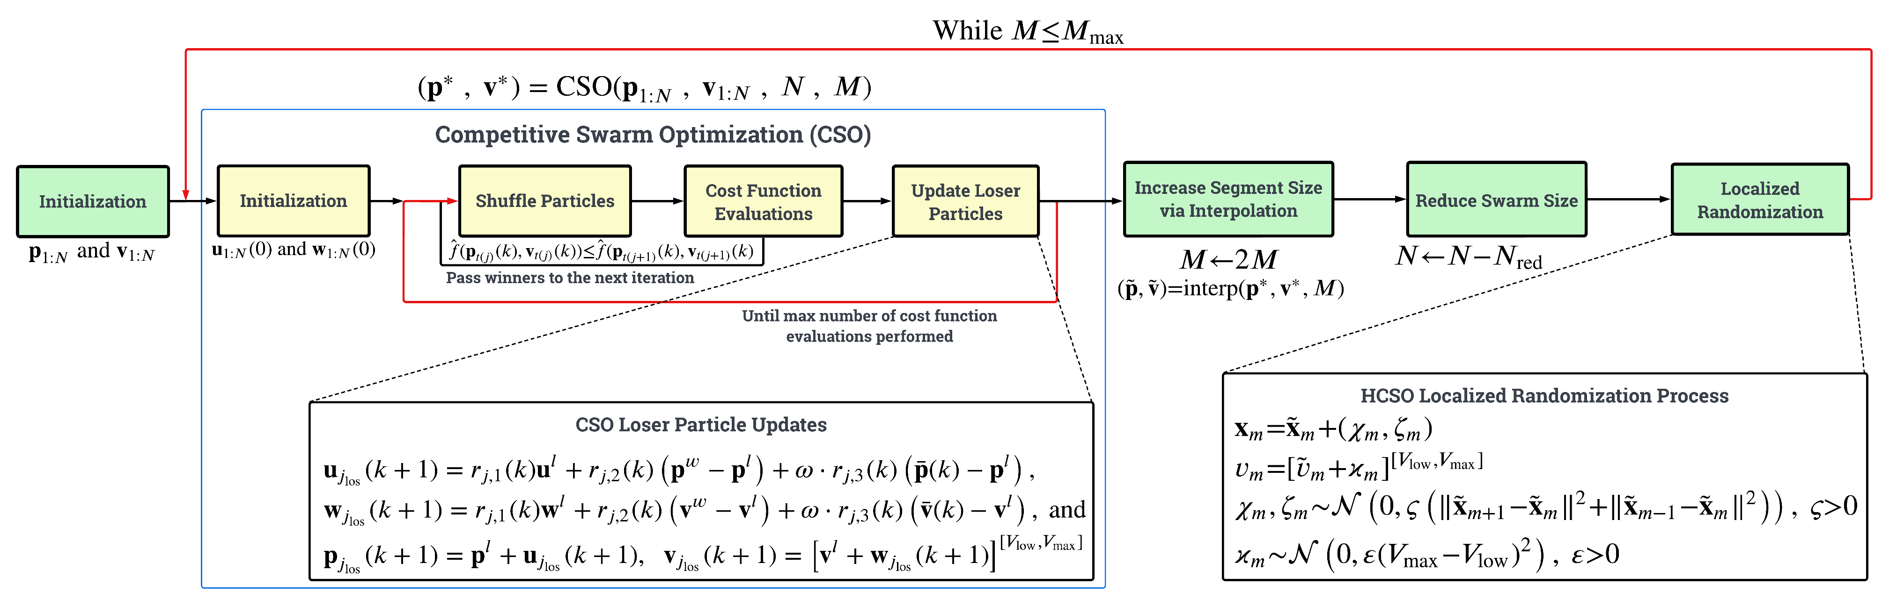
Algorithmic Flow of the HCSO Trajectory Design process

Slide 44

MAESTRO Simulation Setup | Numerical Evaluations

Slide 45
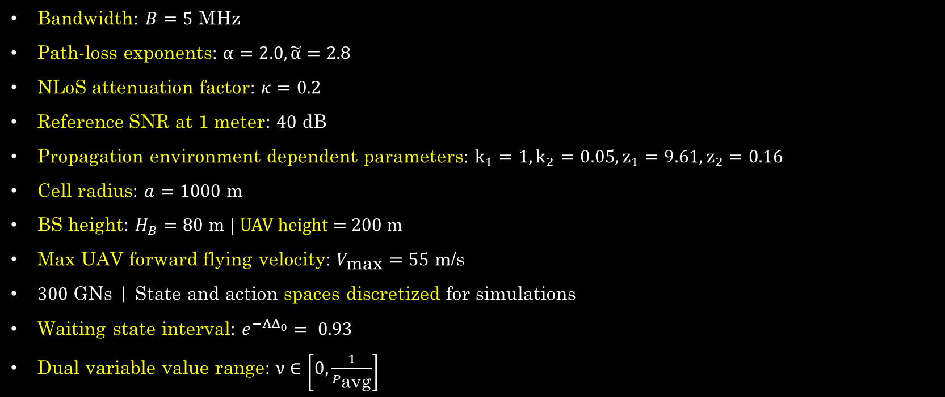
Simulation Setup
Bandwidth: $B=5$ MHz
Path-loss exponents: $α=2.0, \tilde{α}=2.8$
NLoS attenuation factor: $κ=0.2$
Reference SNR at 1 meter: $40$ dB
Propagation environment dependent parameters: $k_{1}=1,k_{2}=0.05,z_{1}=9.61,z_{2}=0.16$
Cell radius: $a=1000 \text{m}$
BS height: $H_{B}=80 \text{m} |$ UAV height = 200 m
Max UAV forward flying velocity: $V_{\text{max}}=55$ m/s
$300$ GNs | State and action spaces discretized for simulations
Waiting state interval: $e^{−ΛΔ_{0}}= 0.93$
Dual variable value range: $ν∈\left[0,\frac{1}{P_{\text{avg}}}\right]$

Slide 46
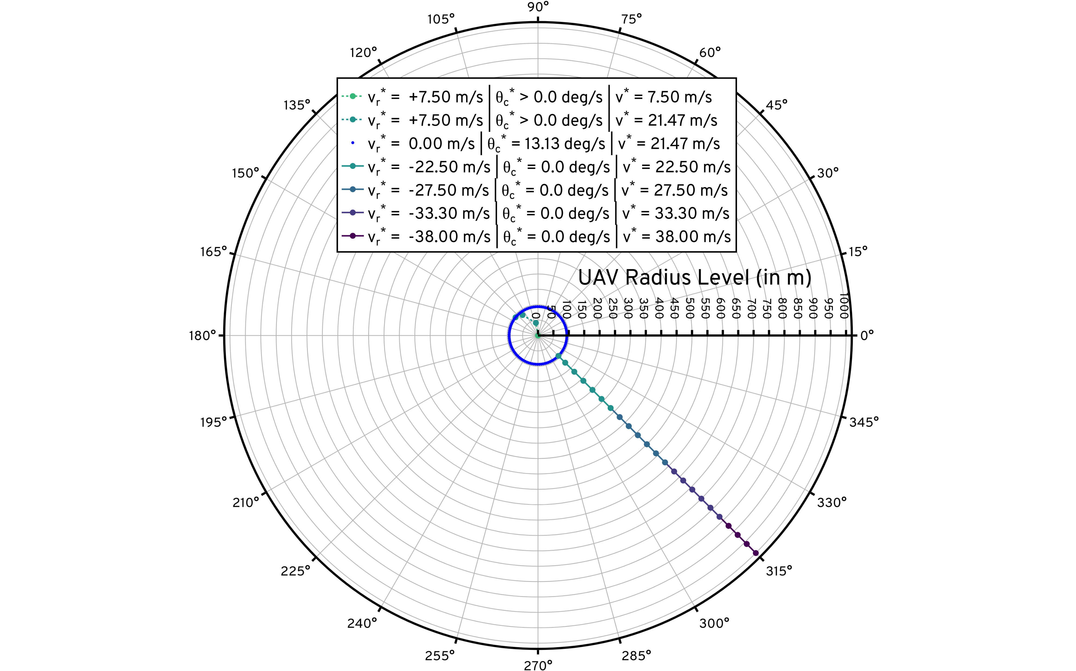
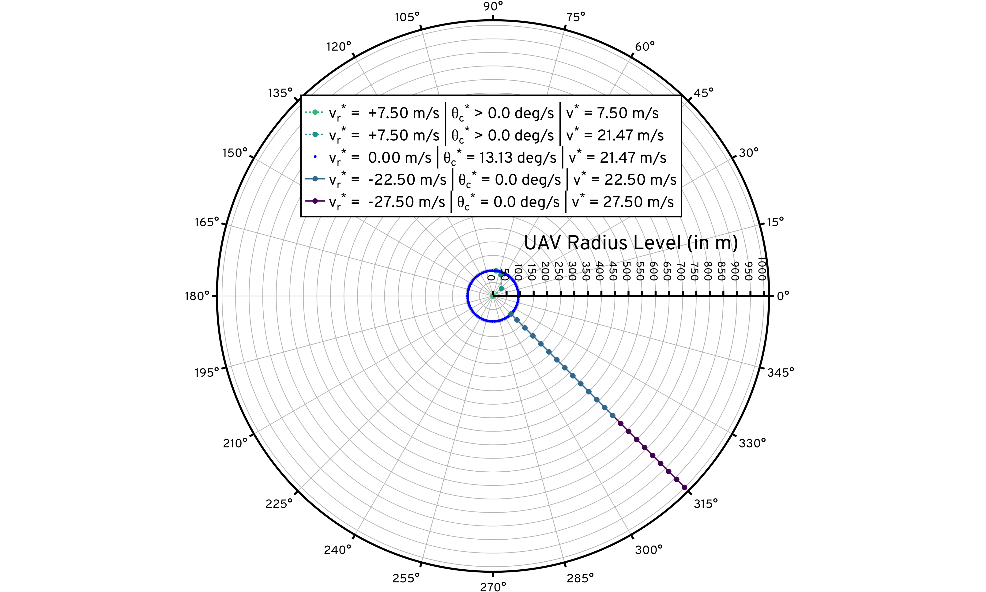
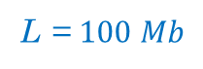
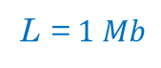
Under smaller data payloads, the UAV returns towards the cell center faster than under larger ones
Less time spent to serve ➔ can afford additional power consumption necessary to fly at higher velocities
L = $1 Mb$
L = $100 Mb$
The radius level in which the UAV has zero optimal radial velocity $≈95 m$
MAESTRO Waiting Policy Visualization: $L=1$ Mb (left) and $L=$100 Mb (right)

Slide 47
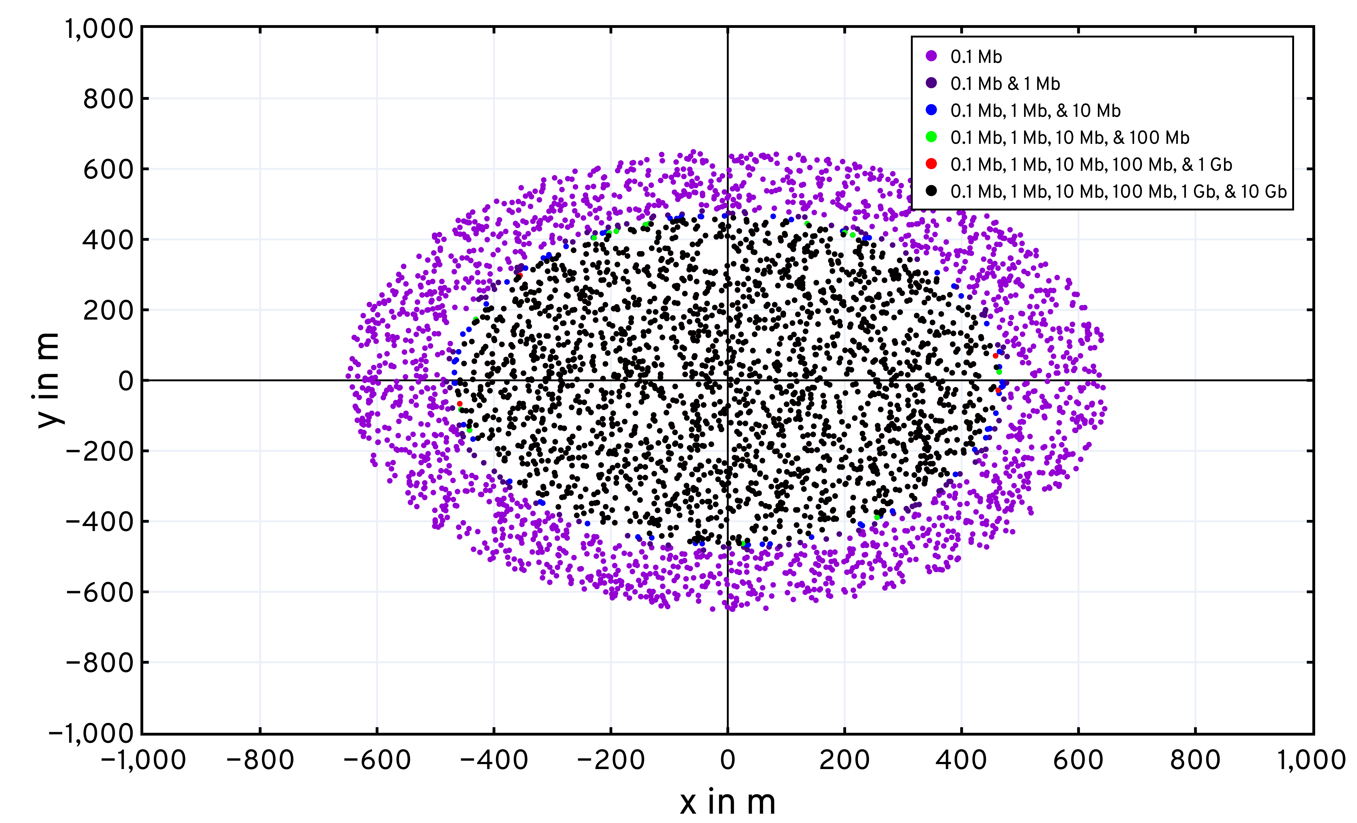
The empty space implies that the requests arising from GNs in that region are served by the UAV via the D&F protocol
MAESTRO Scheduling Visualization: GNs served by the BS directly for varying $L$

Slide 48
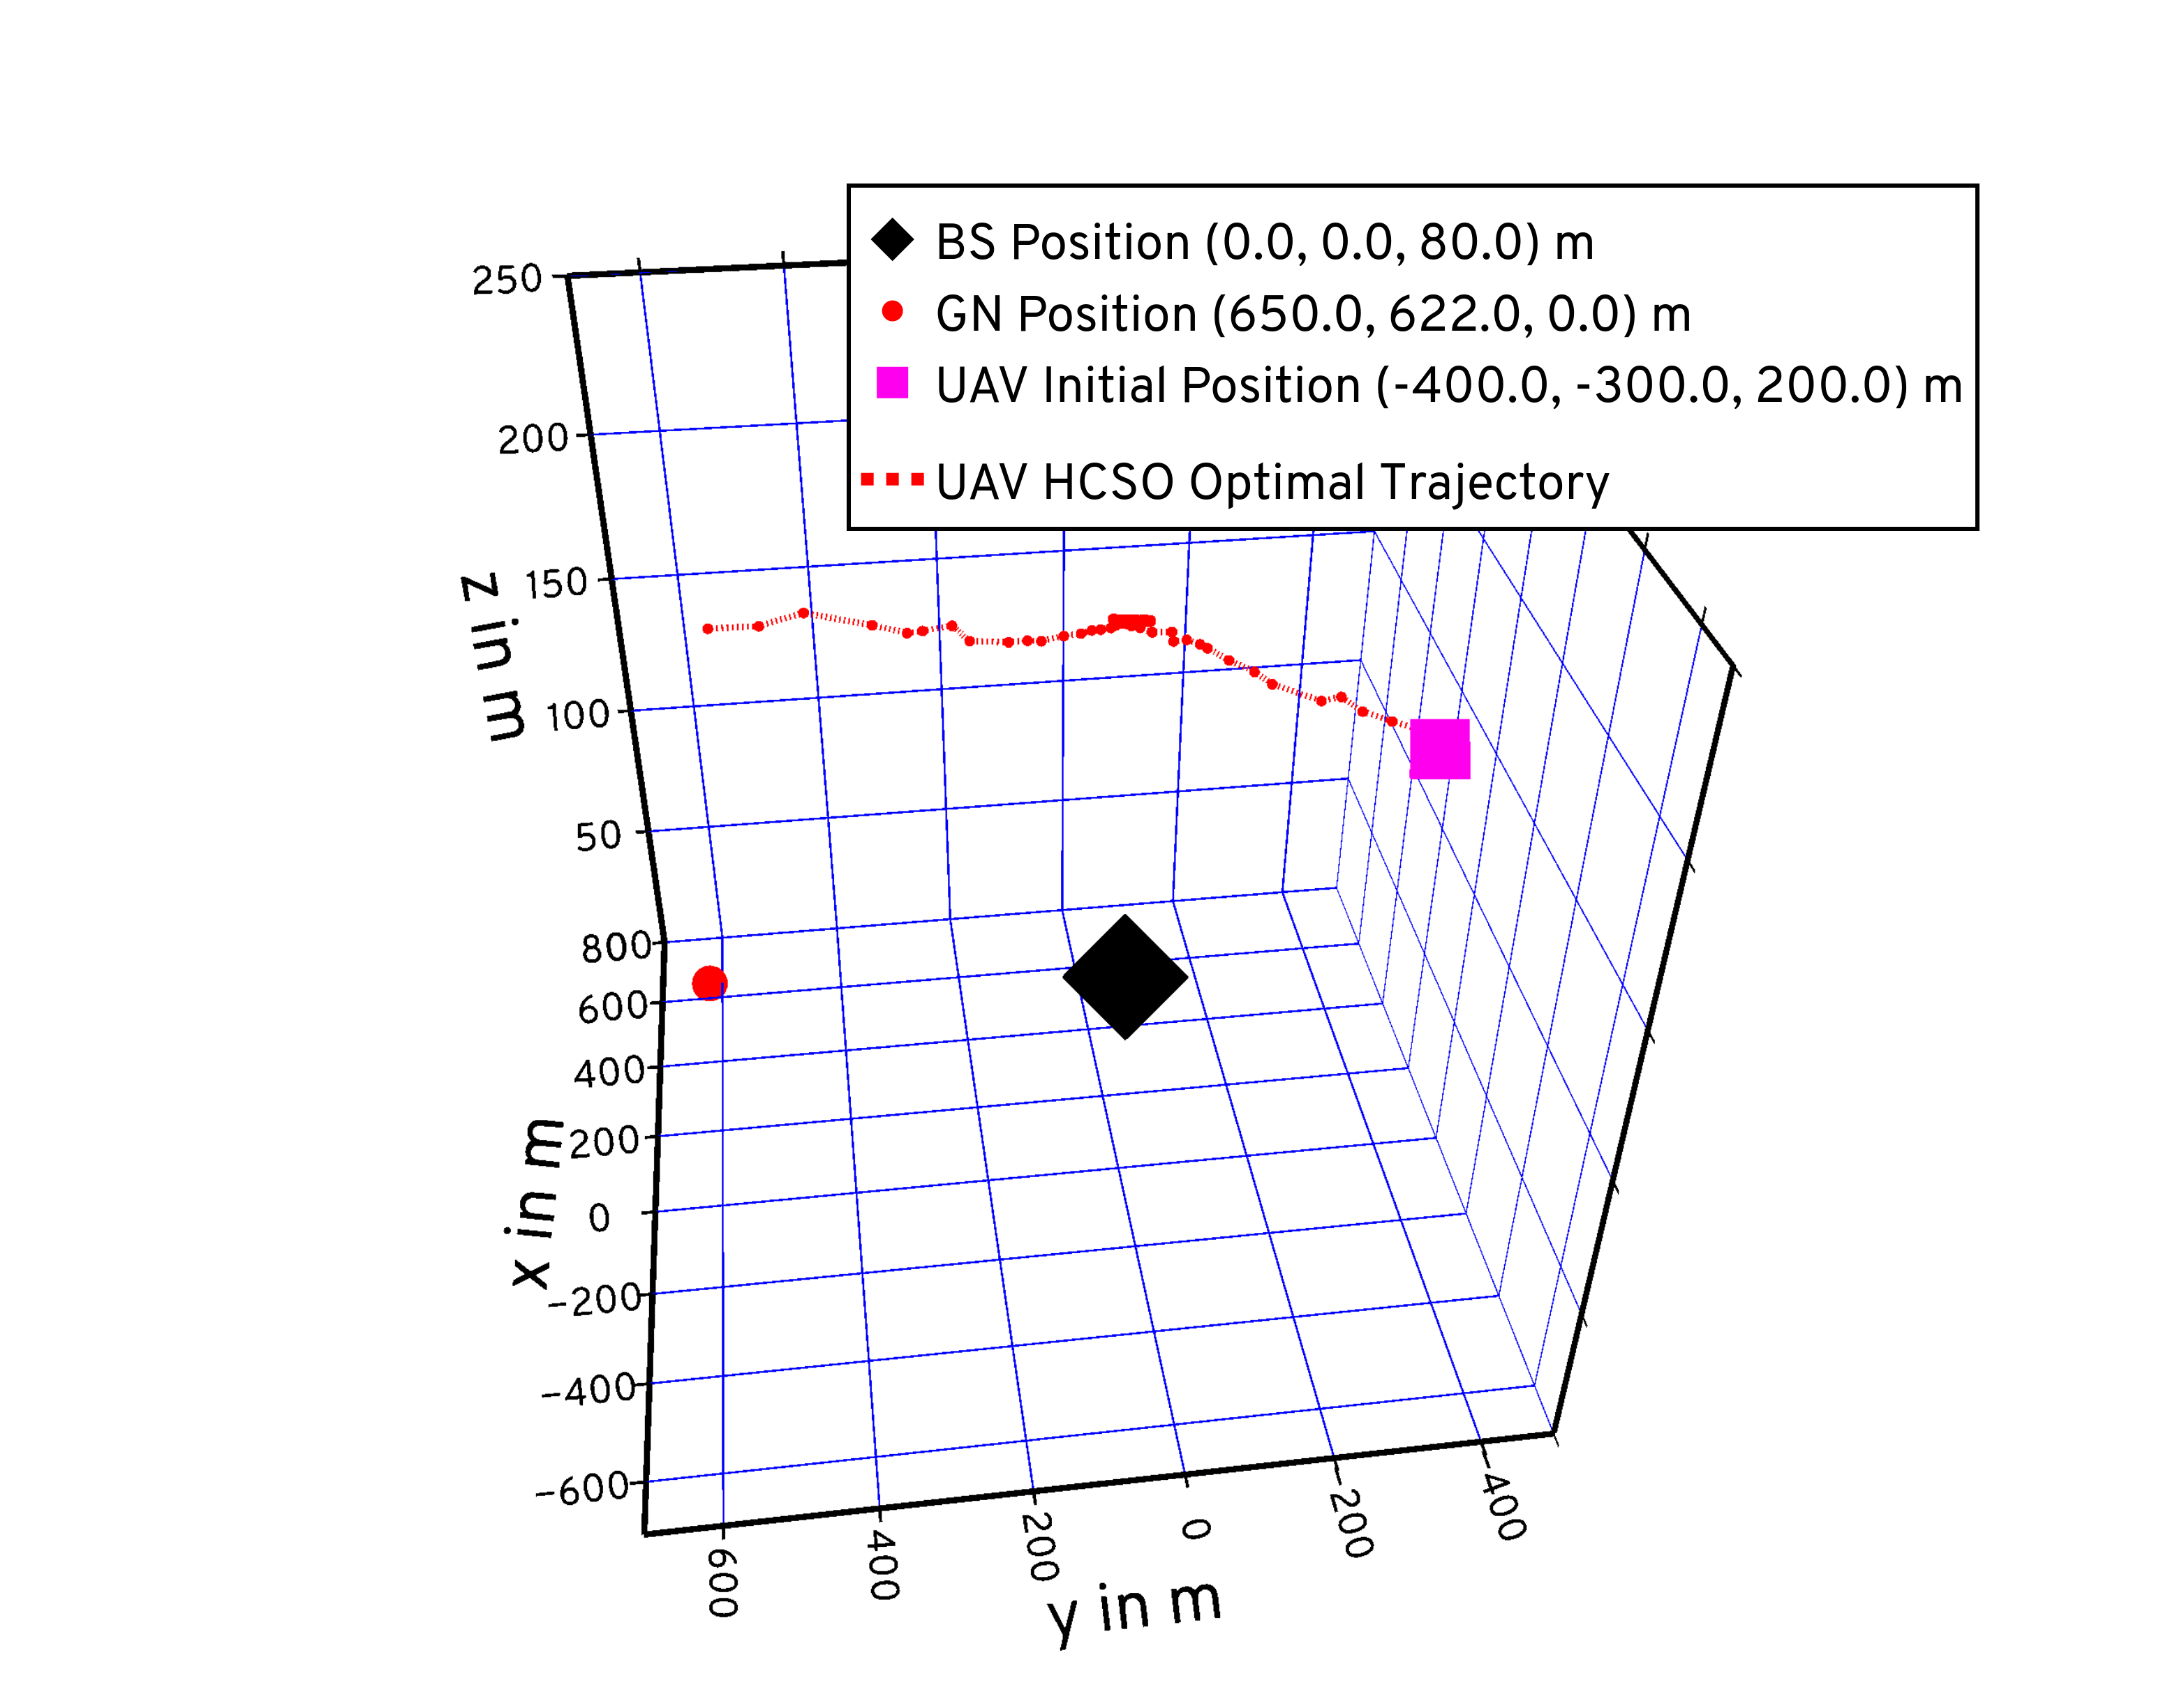
Note that towards the end of the Forward phase, the UAV moves in a circle at the power-minimizing speed about the terminal point in order to complete the data payload forward to the BS | Minimize the energy penalty as opposed to hovering
The UAV’s Terminal Position in the Decode Phase
The UAV’s Terminal Position in the Forward Phase
The UAV’s Initial Position
The Ground Node (GN)
The Base Station (BS)
MAESTRO Trajectory Visualization: Execution to serve GN at $\left(650, 620, 0\right) m$

Slide 49
Generalization to Swarms: eXtended MAESTRO

Slide 50
MAESTRO-X: eXtended MAESTRO
MAESTRO’s single-agent optimal policy is augmented with
Spread Maximization
Radial & angular movements of the UAVs in the waiting phase (CW/CCW)
Conflict Resolution
Scheduling decisions across the swarm in the request scheduling phase
Queue Management
M/G/x queuing models at the BS and the UAVs
Join Fastest Queue and Join Shortest Queue heuristics
BS-UAV and UAV-UAV coordination over a command & control network
Augmented policy is then replicated across the swarm enabling decoupled executions of a single trained policy

Slide 51
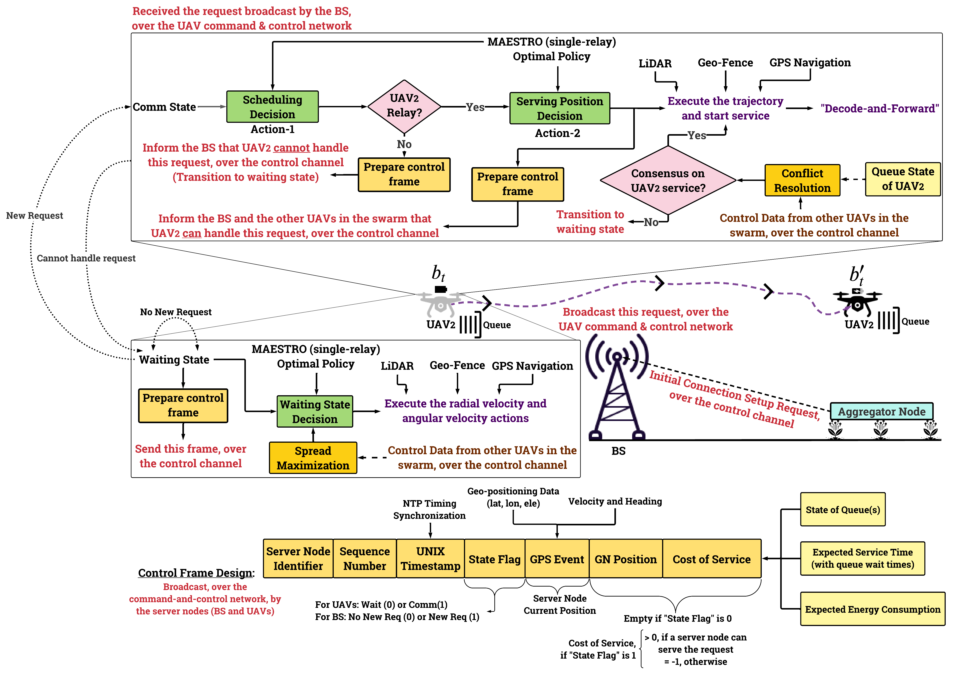
MAESTRO-X: Sample scenario analysis in precision agriculture | Waiting

Slide 52
MAESTRO-X: Sample scenario analysis in precision agriculture | Request Handling

Slide 53
MAESTRO-X: Sample scenario analysis in precision agriculture

Slide 54
MAESTRO-X Numerical Evaluations

Slide 55
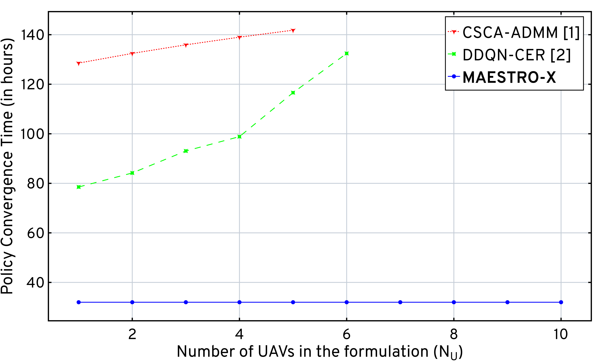
MAESTRO-X: Decoupled executions of a single augmented MAESTRO optimal policy replicated across the swarm
[1] CVXPY implementation using the Split Conic Solver
[2] Double Deep-Q Network implementation in Keras
Computing Accelerations:
Multi-threading concurrency
TensorFlow implementation
Distributed computing
[1] Q. Hu et al., “Low-Complexity Joint Resource Allocation and Trajectory Design for UAV-Aided Relay Networks With the Segmented Ray-Tracing Channel Model,” IEEE TWC, vol. 19, no. 9, pp. 6179–6195, 2020.
[2] H. Bayerlein et al., “Multi-UAV Path Planning for Wireless Data Harvesting With Deep Reinforcement Learning,” IEEE Open Journal of the Communications Society, vol. 2, p. 1171–1187, 2021.
MAESTRO-X Computational Complexity Benchmarking against the state-of-the-art

Slide 56
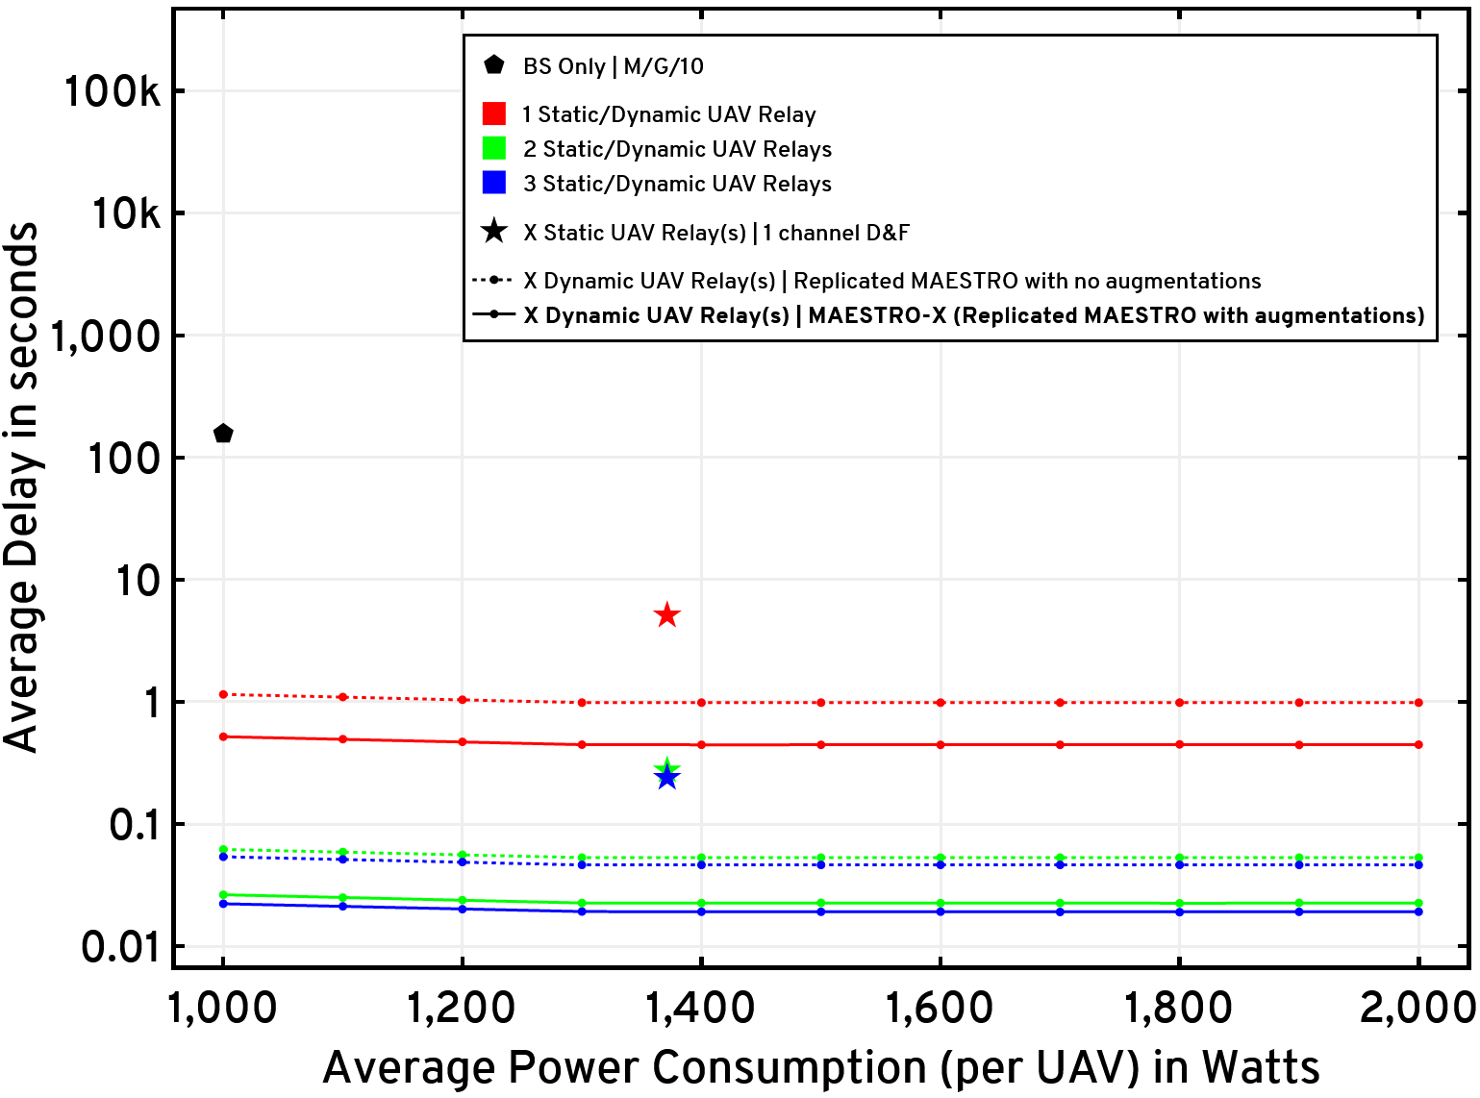
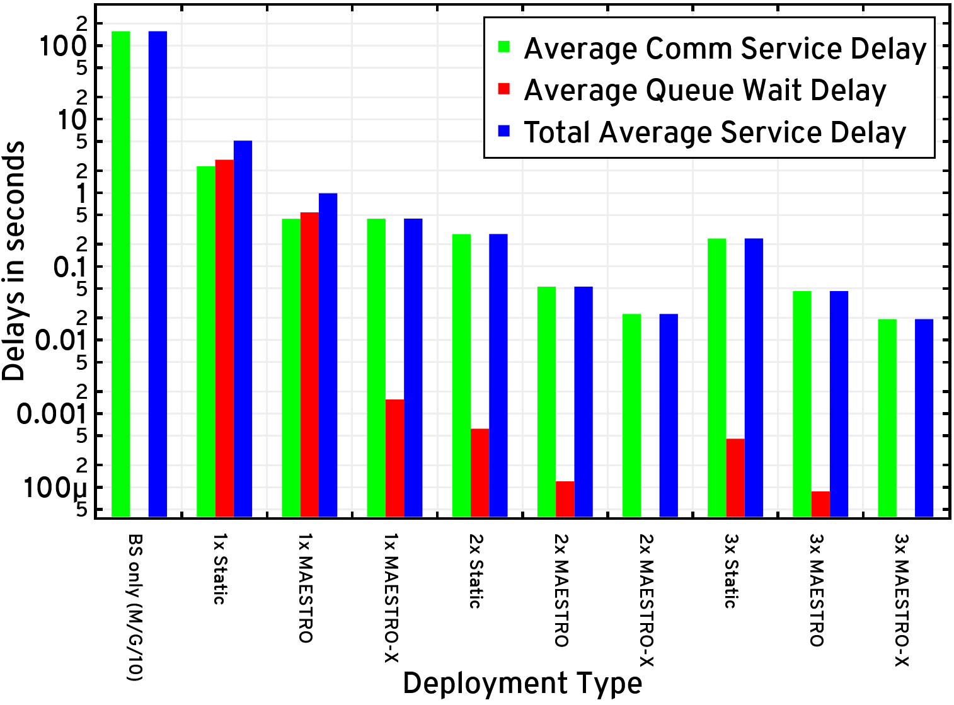




Data Payload Size = 1 Mb | BW = 5 MHz | Arrival Rate = 1 request every minute
BS at (0,0) | BS Height = 80 m | UAV Height = 200 m | UAV Hover Power Consumption = 1.37 kW
Average delay for the GNs versus per-UAV average power constraint
L = 1 Mb | MAESTRO-X Evaluations with various heuristics

Slide 57
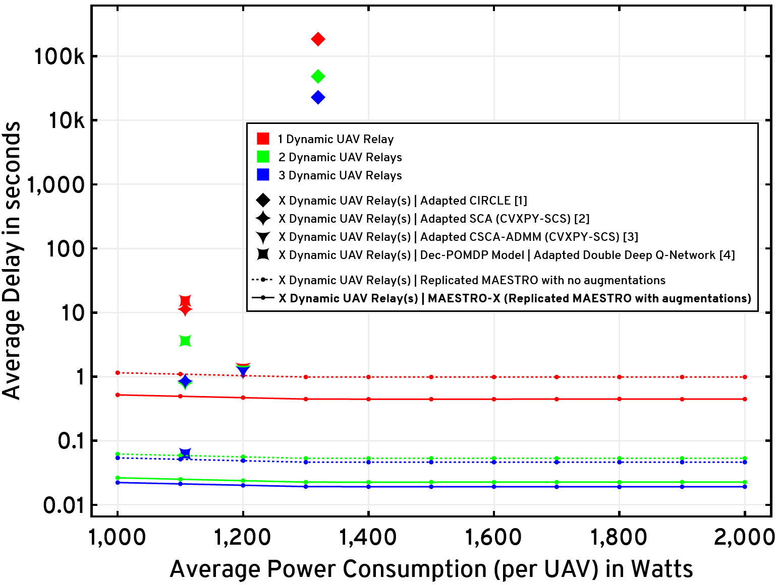
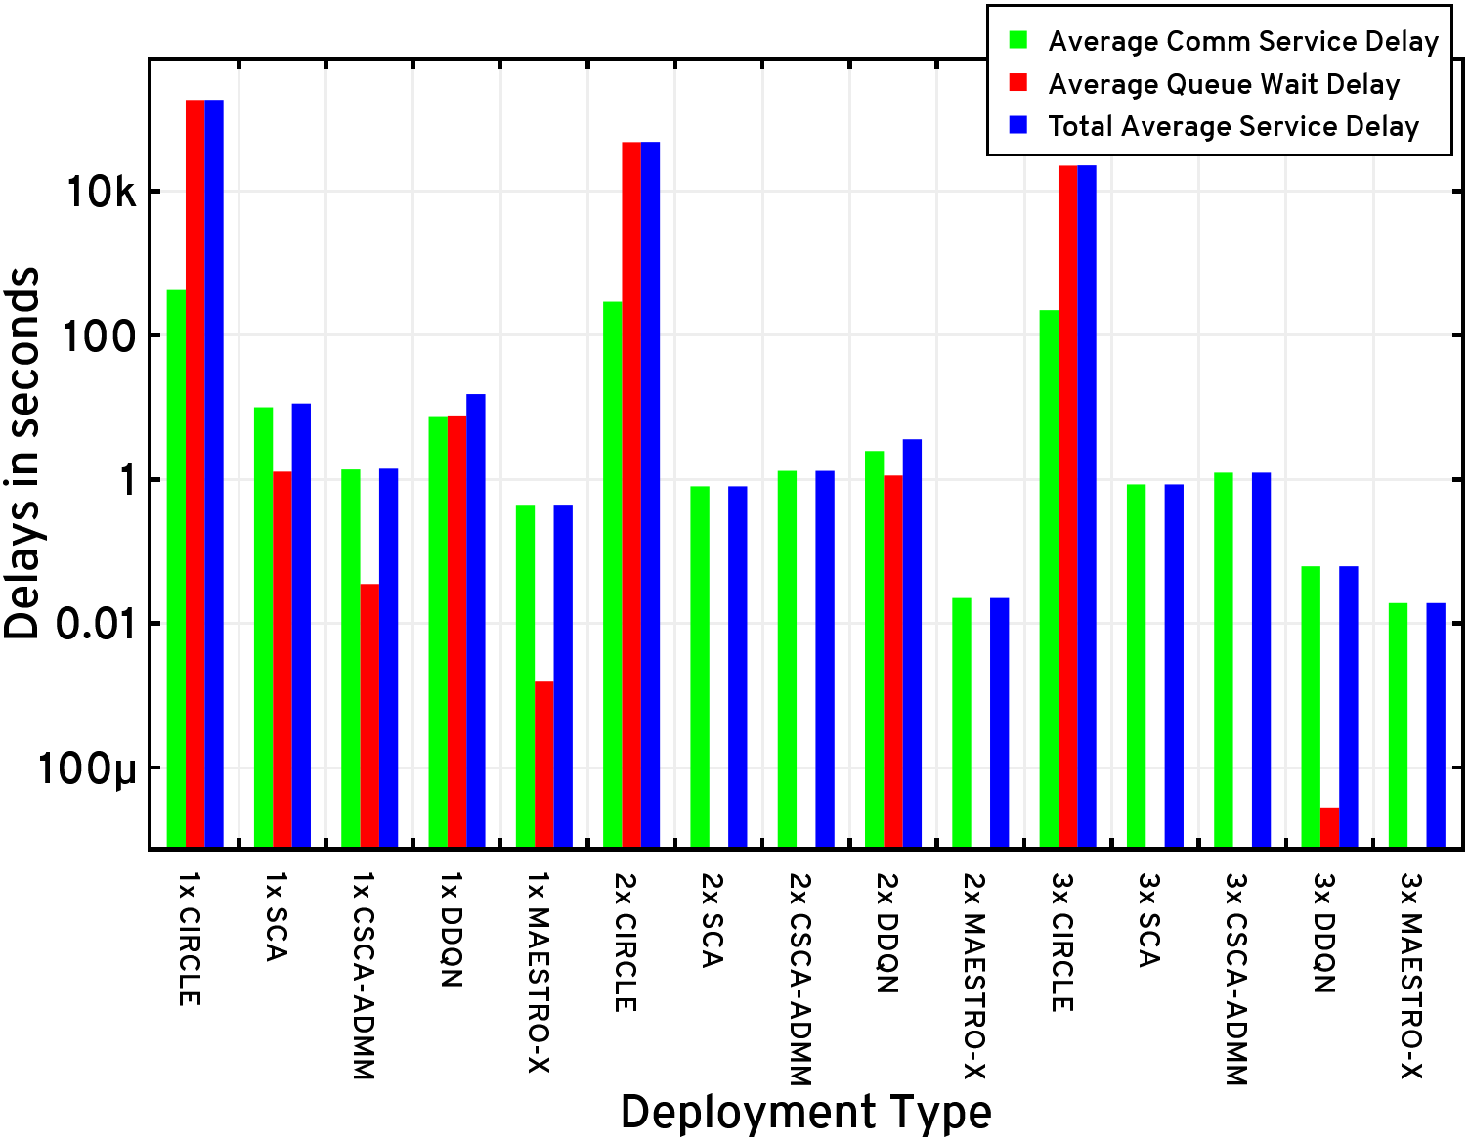



Data Payload Size = 1 Mb | BW = 5 MHz | Arrival Rate = 1 request every minute
BS at (0,0) | BS Height = 80 m | UAV Height = 200 m | UAV Hover Power Consumption = 1.37 kW
Average delay for the GNs versus per-UAV average power constraint
L = 1 Mb | MAESTRO-X Evaluations against the state-of-the-art
[1] L. Wang, et al., “Multi-Agent Deep Reinforcement Learning-Based Trajectory Planning for Multi-UAV Assisted Mobile Edge Computing,” IEEE Transactions on Cognitive Communications and Networking, vol. 7, no. 1, pp. 73–84, 2021.
[2] Y. Zeng et al., “Energy Minimization for Wireless Communication With Rotary-Wing UAV,” IEEE Transactions on Wireless Communications, vol. 18, no. 4, pp. 2329–2345, April 2019.
[3] Q. Hu et al., “Low-Complexity Joint Resource Allocation and Trajectory Design for UAV-Aided Relay Networks With the Segmented Ray-Tracing Channel Model,” IEEE TWC, vol. 19, no. 9, pp. 6179–6195, 2020.
[4] H. Bayerlein et al., “Multi-UAV Path Planning for Wireless Data Harvesting With Deep Reinforcement Learning,” IEEE Open Journal of the Communications Society, vol. 2, p. 1171–1187, 2021.

Slide 58
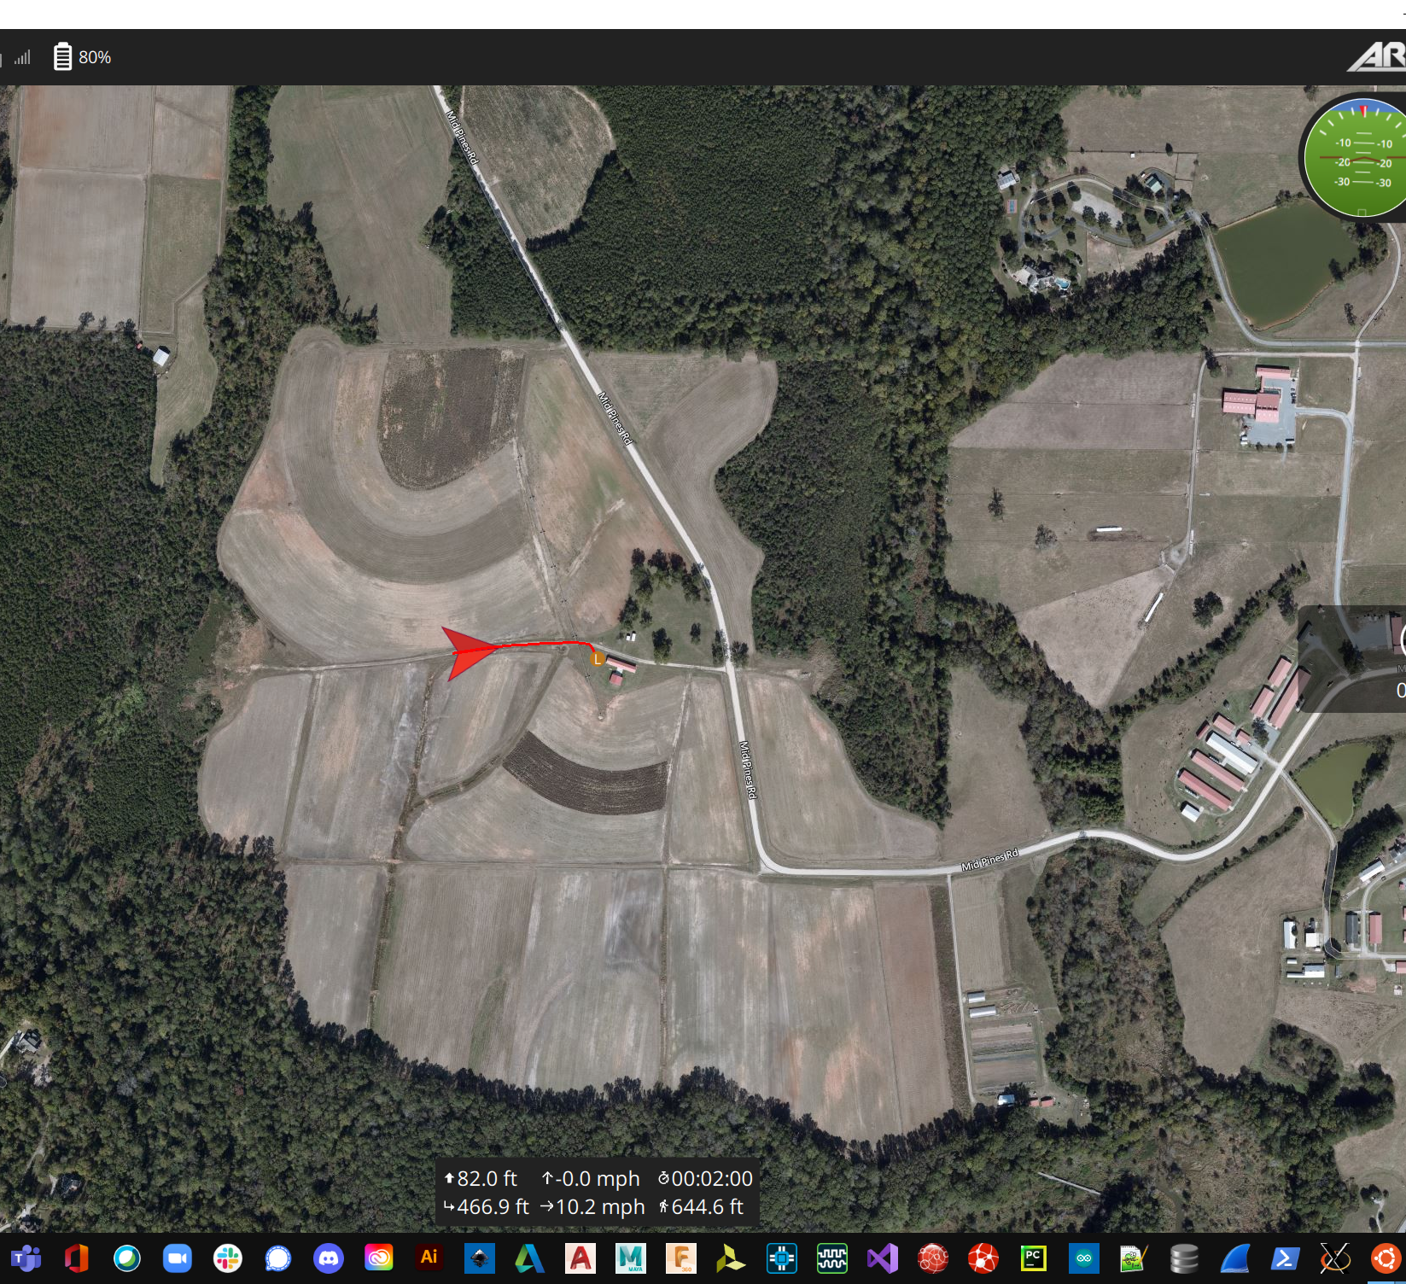
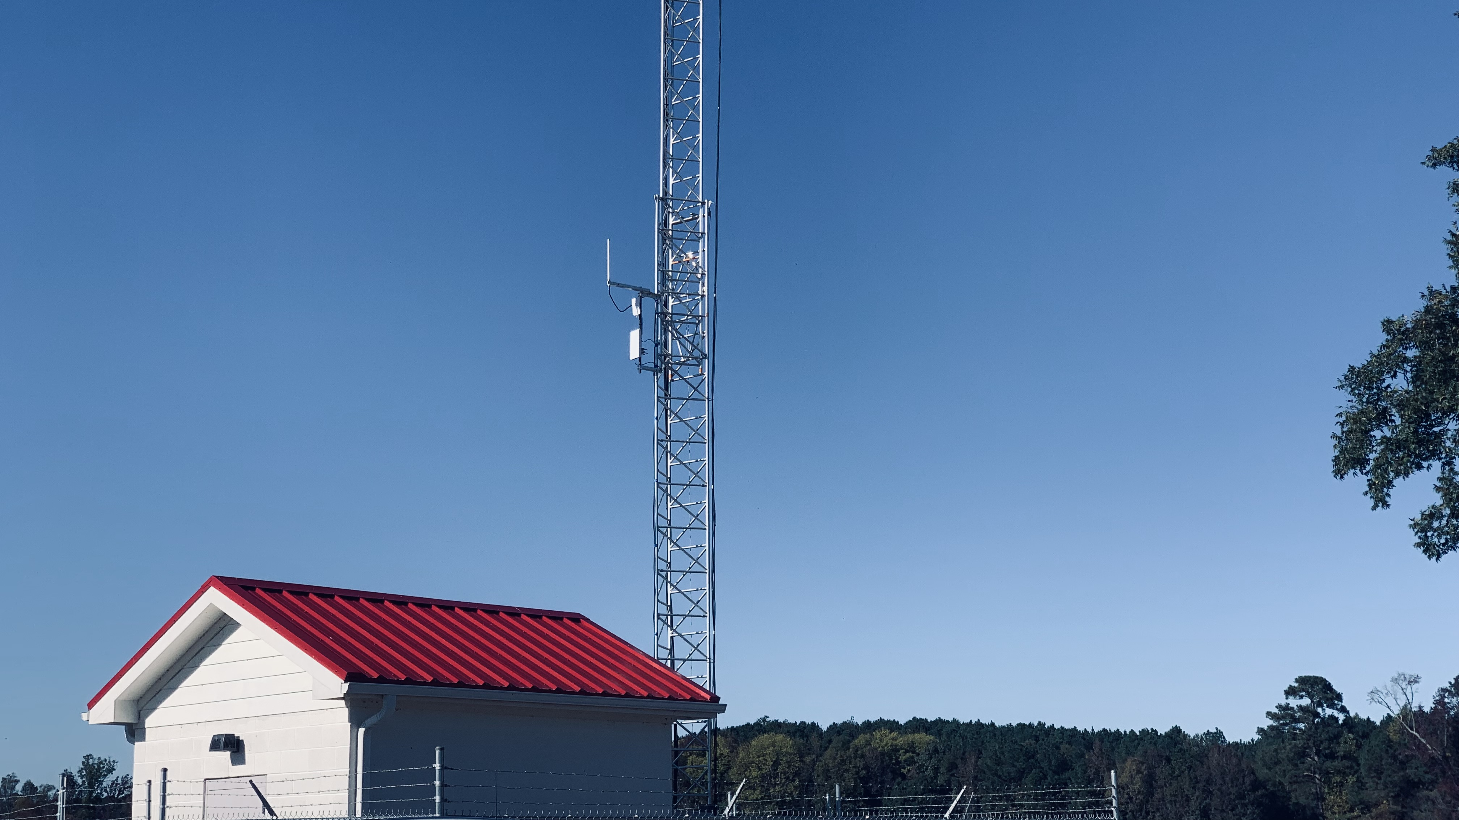
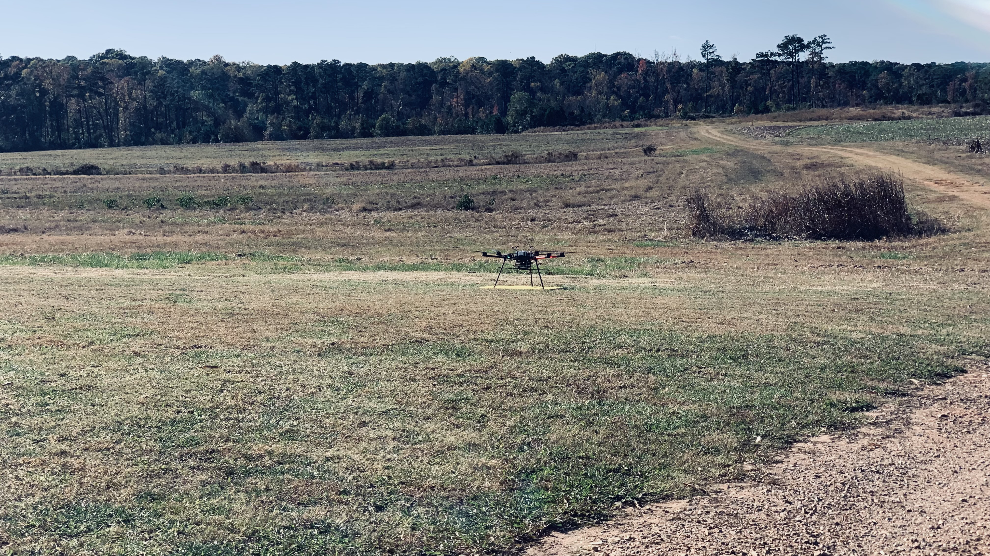
NSF AERPAW
Emulations & In-flight tests

Slide 59
Conclusion
The UAV relays augment the coverage and service capabilities of a terrestrial base station
Dynamic traffic from miscellaneous sets of randomly distributed ground users (UEs/IoT-sensors)
A2G channel model with rate-adaptation at all transmitters to maximize the system throughput
MAESTRO: Specialized to single-relay constructions:
Outer decisions on radial wait velocities and UAV service schedules & terminal service positions (SMDP value iteration)
Given outer decisions, inner decisions on angular wait velocities (exhaustive search) and UAV service trajectories (HCSO)
MAESTRO-X: Supplement this policy with multi-UAV heuristics
Spread maximization | Conflict resolution | Queue management
Replicate this augmented policy across the UAV swarm
Performance comparisons with relevant schemes in the state-of-the-art as well as with policy-driven heuristics

Slide 60

Future Work

Slide 61
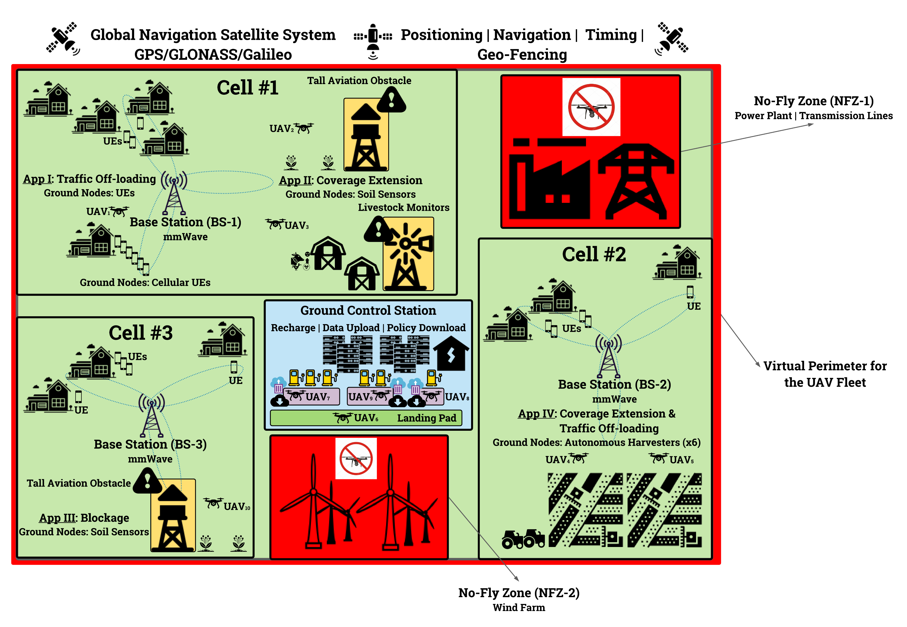
Future Work: System Architecture

Slide 62
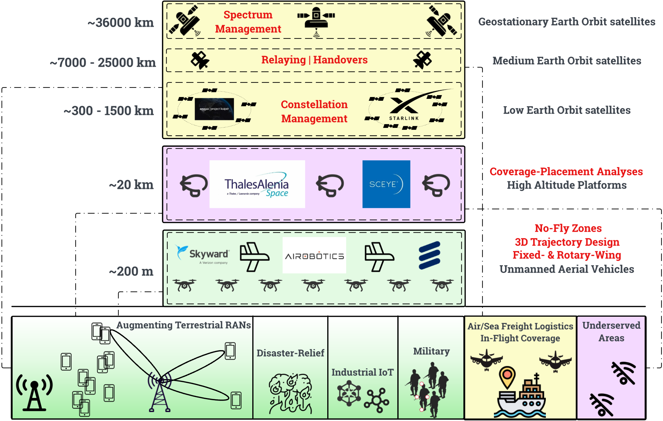
Future Work: Multi-Tier Application-Specific Vision

Slide 63

Future Work: Traffic Classes or Prioritized Network Flows

Slide 64

Future Work: Deep RL Architecture for Distributed Swarm Orchestration

Slide 65
Thank you

Slide 66
Q&A

